Slide 1
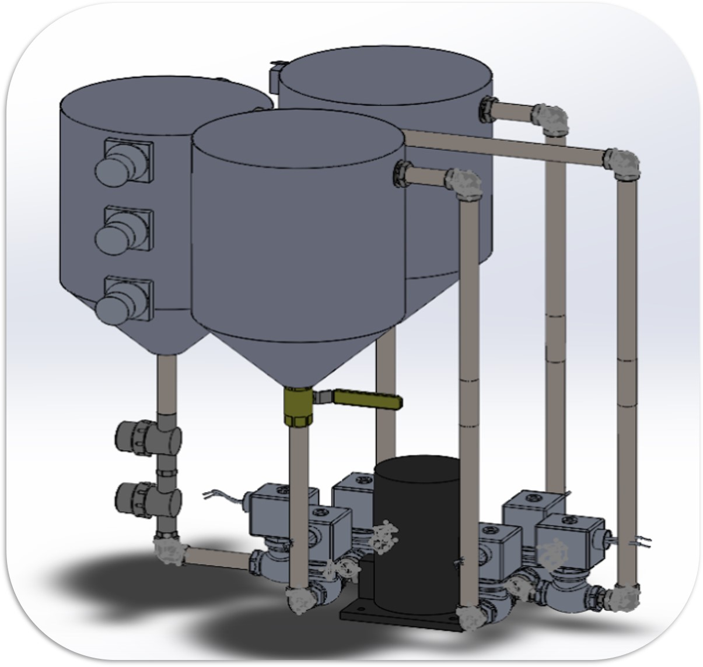
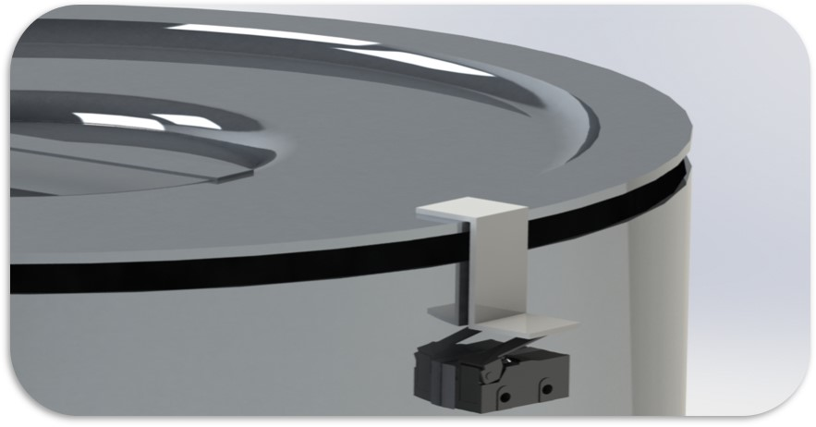
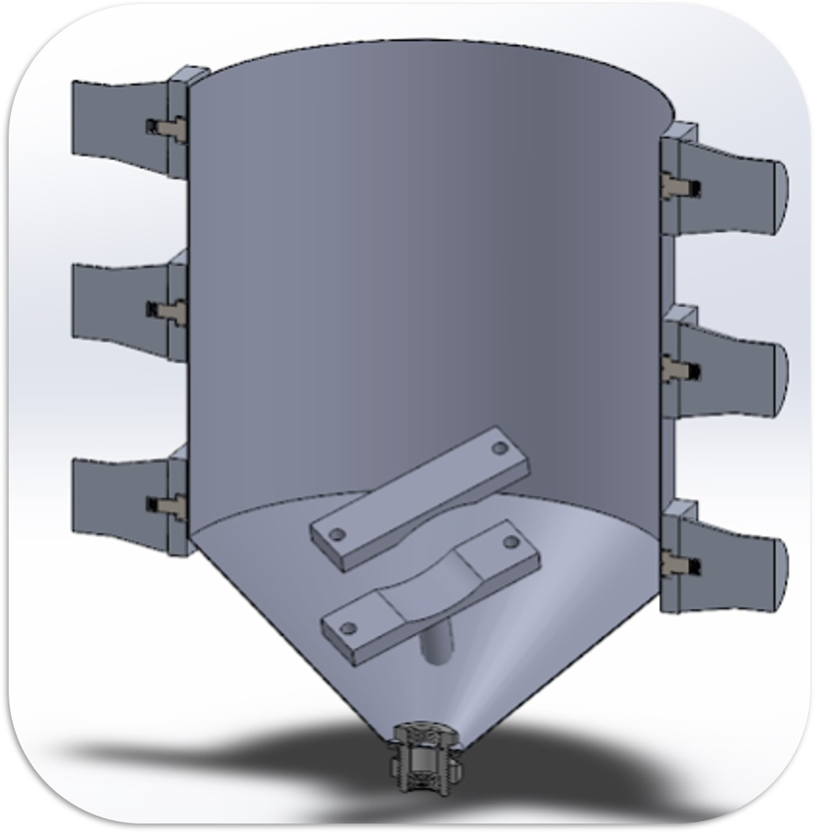
Optimization and Partial Demonstration of Oxalic Acid Dissolution System
Senior Design I- Spring 2020
Team Members: Rachel Glendenning, Esther Lee, Quentin McCullough, Matt Parise, Andrew Straight
Industry Supporter: Arthur Niemoller, Sven Bader
Faculty Mentor: Dr. Thomas Koch
Mixing
Cleaning
Deconstruction
Objective
System Overview
Objective
To develop a system and process for cleaning piping that removes and captures corrosion and contaminants using an oxalic acid mixture. The system must also demonstrate complete oxalic destruction.
Cleaning Tank
Recovery Tank
To remove metallic scales in pipes
Agitation, continuous flow, and heating
Design Features:
Immersion heater
6 ultrasonic transducers
Pipe mount
50 and 200 T-filters to collect metallic scales
Oxalic acid destruction
UV Light, ozone, or peroxide
Fail-safety switch for no UV light exposure
Mixing
Optimization and Partial Demonstration of Oxalic Acid Dissolution System
Senior Design I- Spring 2020
Cleaning
Deconstruction
Electrical
Make Up Tank
All electrical components are connected on a 16-relay module, with Arduino used to control. A control panel will be used to protect against current surges.
Mechanical valve to ensure mixing is complete before entering piping
Performance Specifications
To create an oxalic acid and water solution
Design Features:
3 Gallon Stainless Steel Tank
1/32 inch wall thickness
Mechanical valve to ensure mixing is complete before entering piping
The system will use a mixing, cleaning, and recovery tank placed in a 3’x 4’ area
Testing samples: Uniform size, corroded metal pipe
Oxalic acid destruction methods:
Ultraviolet light
H₂O₂ (Hydrogen Peroxide)
O₃ (Ozone)
Future Work
Summer 2020:
Complete electrical control panel design
Start fabrication
Fall 2020:
Complete fabrication and assembly
Perform testing to determine optimal
Oxalic acid concentration
Agitation time
Flow rate
Temperature
Deconstruction method
Pump and Piping
Contact Information
Pump
3 Phase, self priming, centrifugal pump
⅛ HP
Max flow rate 10 GPM
Max particle diameter 3/32 inch
Piping
304 Stainless Steel
¼” NPT diameter
7’ of total piping
Fittings and connections coated with pipe sealant
Rachel Glendenning (ME): rglenden@uncc.edu
Esther Lee (MET): elee60@uncc.edu
Quentin McCullough (ME): qmccullo@uncc.edu
Matthew Parise (MET): mparise1@uncc.edu
Andrew Straight (SE): astraigh@uncc.edu

Slide 2
Optimization and Partial Demonstration of Oxalic Acid Dissolution System
Senior Design I- Spring 2020
Team Members: Rachel Glendenning, Esther Lee, Quentin McCullough, Matt Parise, Andrew Straight
Industry Supporter: Arthur Niemoller, Sven Bader
Faculty Mentor: Dr. Thomas Koch
Mixing
Cleaning
Deconstruction
Objective
Objective
To develop a system and process for cleaning piping that removes and captures corrosion and contaminants using an oxalic acid mixture. The system must also demonstrate complete oxalic destruction.
Mixing
Cleaning
Deconstruction
Performance Specifications
The system will use a makeup, cleaning, and recovery tank placed in a 3’x 4’ area
Testing samples: Uniform size, corroded metal pipe
Oxalic acid destruction methods:
Ultraviolet light
H₂O₂ (Hydrogen Peroxide)
O₃ (Ozone)

Slide 3
Optimization and Partial Demonstration of Oxalic Acid Dissolution System
Senior Design I- Spring 2020
Team Members: Rachel Glendenning, Esther Lee, Quentin McCullough, Matt Parise, Andrew Straight
Industry Supporter: Arthur Niemoller, Sven Bader
Faculty Mentor: Dr. Thomas Koch
System Overview
Make Up Tank
To create an oxalic acid and water solution
Design Features:
3 Gallon Stainless Steel Tank
1/32 inch wall thickness
Mechanical valve to ensure mixing is complete before entering piping
Optimization and Partial Demonstration of Oxalic Acid Dissolution System
Senior Design I- Spring 2020
Mechanical valve to ensure mixing is complete before entering piping
Pump and Piping
Pump
3 Phase, self priming, centrifugal pump
⅛ HP
Max flow rate 10 GPM
Max particle diameter 3/32 inch
Piping
304 Stainless Steel
¼” NPT diameter
7’ of total piping
Fittings and connections coated with pipe sealant

Slide 4
Optimization and Partial Demonstration of Oxalic Acid Dissolution System
Senior Design I- Spring 2020
Team Members: Rachel Glendenning, Esther Lee, Quentin McCullough, Matt Parise, Andrew Straight
Industry Supporter: Arthur Niemoller, Sven Bader
Faculty Mentor: Dr. Thomas Koch
System Overview
Objective
Cleaning Tank
To remove metallic scales in pipes
Agitation, continuous flow, and heating
Design Features:
Immersion heater
6 ultrasonic transducers
Pipe mount
50 and 200 T-filters to collect metallic scales
Mechanical valve to ensure mixing is complete before entering piping

Slide 5
Optimization and Partial Demonstration of Oxalic Acid Dissolution System
Senior Design I- Spring 2020
Team Members: Rachel Glendenning, Esther Lee, Quentin McCullough, Matt Parise, Andrew Straight
Industry Supporter: Arthur Niemoller, Sven Bader
Faculty Mentor: Dr. Thomas Koch
System Overview
Objective
Recovery Tank
Oxalic acid destruction
UV Light, ozone, or peroxide
Fail-safety switch for no UV light exposure
Mechanical valve to ensure mixing is complete before entering piping
Electrical
All electrical components are connected on a 16-relay module, with Arduino used to control. A control panel will be used to protect against current surges.

Slide 6
Optimization and Partial Demonstration of Oxalic Acid Dissolution System
Senior Design I- Spring 2020
Team Members: Rachel Glendenning, Esther Lee, Quentin McCullough, Matt Parise, Andrew Straight
Industry Supporter: Arthur Niemoller, Sven Bader
Faculty Mentor: Dr. Thomas Koch
Future Work
Summer 2020:
Complete electrical control panel design
Start fabrication
Fall 2020:
Complete fabrication and assembly
Perform testing to determine optimal
Oxalic acid concentration
Agitation time
Flow rate
Temperature
Deconstruction method
Mechanical valve to ensure mixing is complete before entering piping

