Slide 1
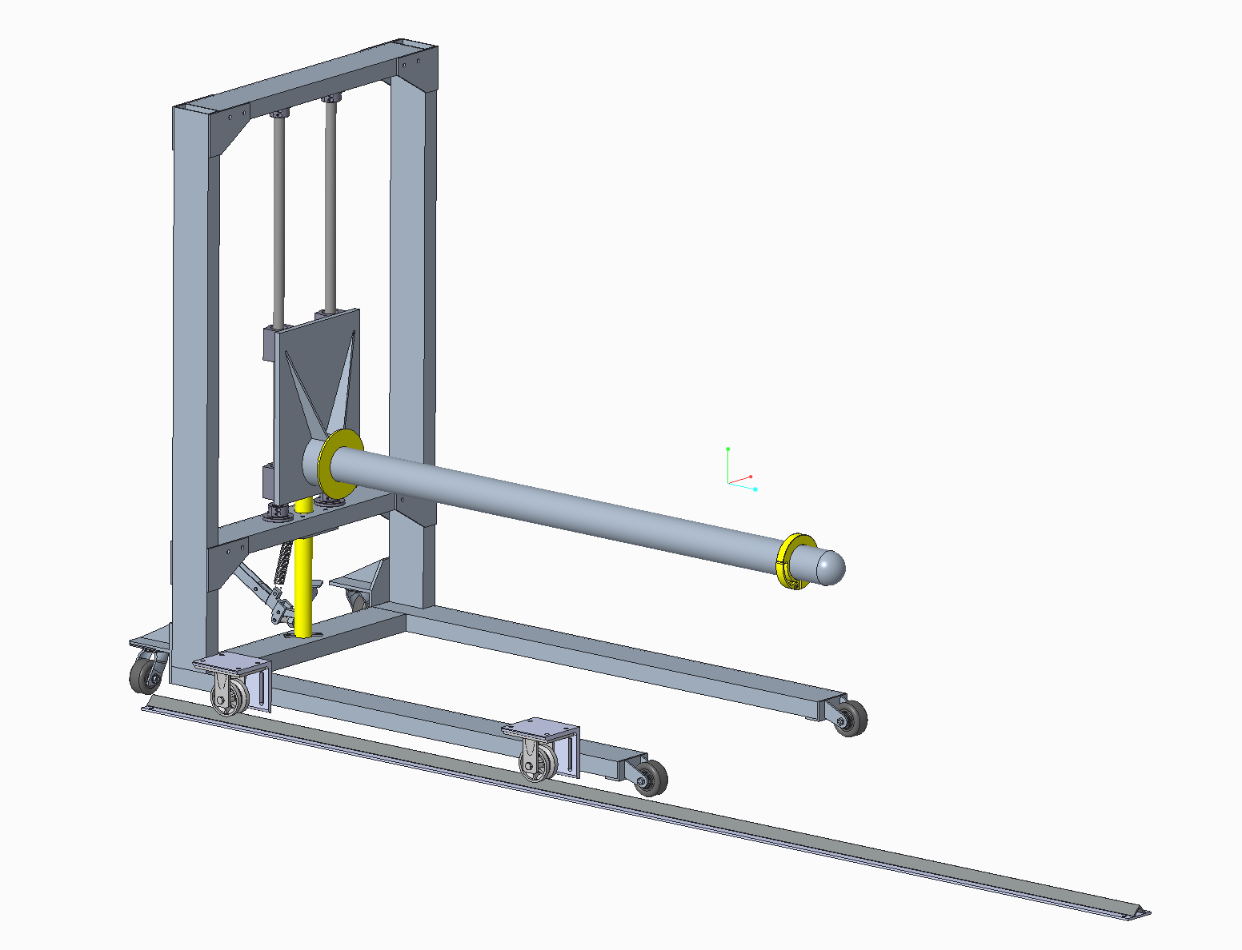
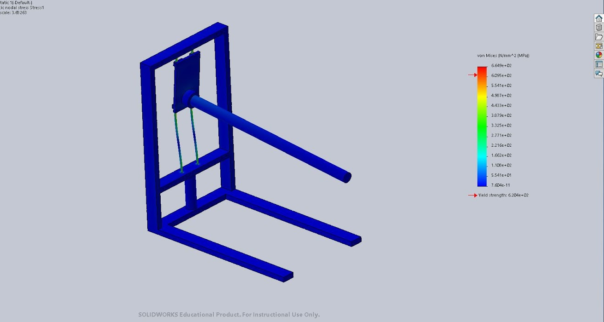
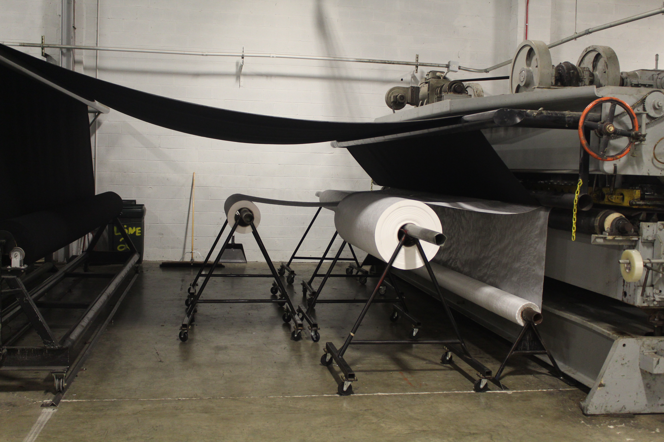
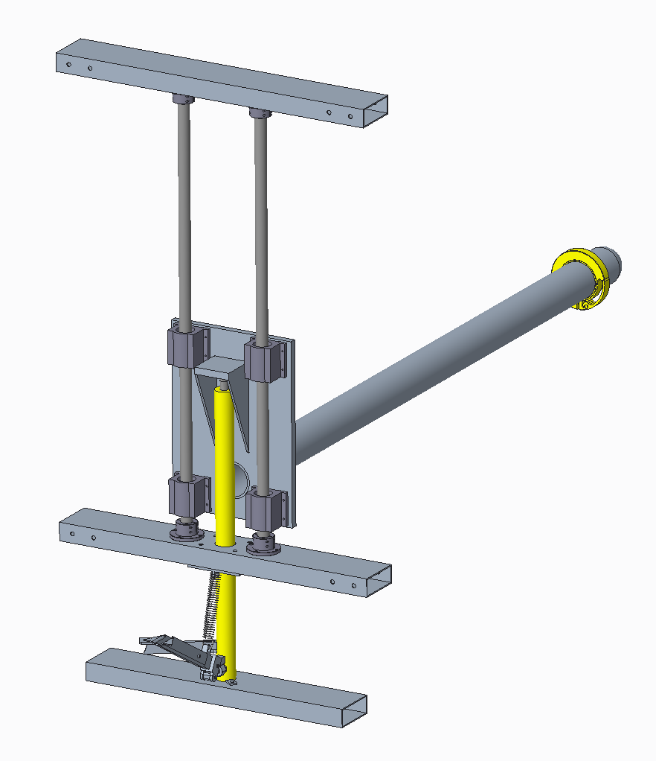
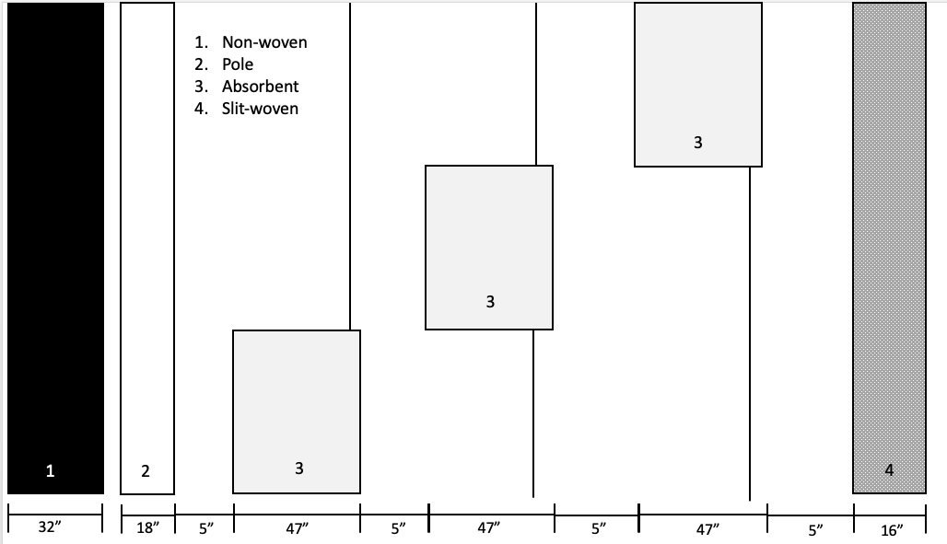
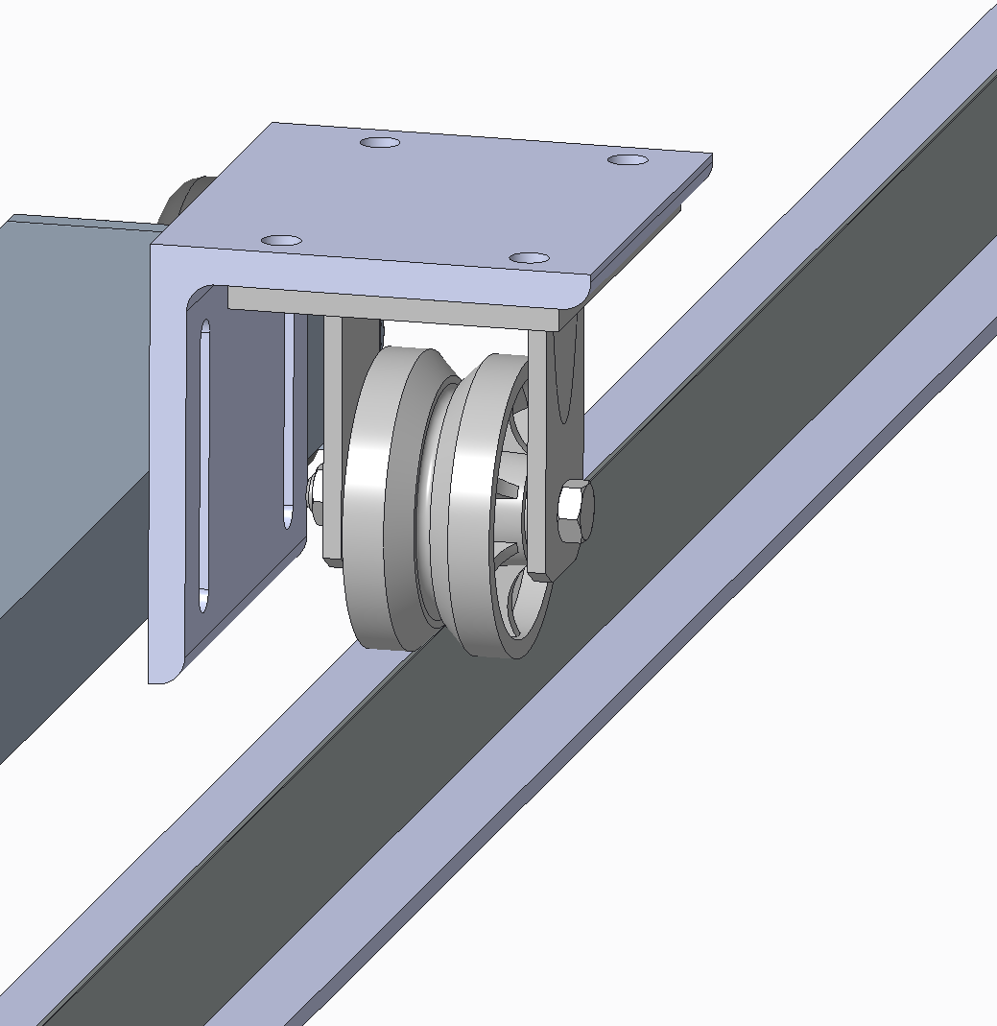
RAW MATERIAL HANDLING SYSTEM Senior Design I – Spring 2020 Industry Supporter: Louis Motew Project Mentor: Dr. Jerry Dahlberg
Project Background and Objective
Design Overview
Current Progress
Huesker Inc. feeds raw material rolls into machinery to produce composite geotextile fabrics
Current feed system is not dynamic:
Material changeover is time/labor intensive
Materials drift when fed, diminishing product quality
Development of a new system that will:
Ensure quicker material changes
Reduce variation of product quality
Improve work environment safety
Design consists of three sub-systems: Frame, Carriage, and Track
Prototype will focus on being used for middle layer absorbent (material 3 in Figure 2)
3D CAD design of all subsystems
In-depth bill of materials
Manufacturing/Testing plan for Fall 2020
Simulation of Carriage sub-system
Subsystem 1: Frame
2”x5” welded steel tube
Multi-directional casters for mobility
Critical sections utilize bolted connections for ease of maintenance/repair
Low profile design for clearance under floored absorbent roll
Figure 3: CAD drawing of assembled design
Figure 6: Results from stress simulation on carriage
Plans for Fall 2020 Semester
Subsystem 2: Carriage
Hydraulic jack to lift material to operational height
1.25” Linear shaft and bearings for load management, designed for minimal maintenance
Gussets placed strategically to reinforce system
Custom built quick release collar to easily secure roll to pole
Adjustable locking safety mechanism relieves jack of material load during operation
Manufacturing
Order parts by the end of August.
By early September:
Weld and assemble the frame.
Assemble the track system.
Manufacture carriage subsystem by the middle of September.
Combine and assemble the whole system by the end of September.
Testing
Verify functionality of prototype at UNCC CAB facility late September
Prototype implemented in Shelby facility early October:
Record time, number of workers, and instances of lifting during changeover
Measure drifting of material over manufacturing cycle
Figure 1: Current material feed system
Performance Specifications
Reduce material changeover times by 25%
Decrease drifting of raw material feed by 50%
Reduce instances workers lift materials by 25%
Decrease workers necessary for changeover by at least one
Decrease workers necessary for operating needling machine by at lease one
Figure 4: CAD drawing of carriage assembly
Subsystem 3: Track
V-groove track engages with v-groove wheels to guide and position absorbent jack
Positioning lead screw for fine adjustment of absorbent jack relative to operating machinery
Plunger pins lock the machine into the floor, securing jack during operation
Expected Results
Fully functioning prototype by mid-October that will:
Reduce workers used for changeover from 3-4 to 2
Reduce workers used to operate needling machine from 3-4 to 2
No forklift operator needed
Installation manual and Operator’s manual
Figure 2: Composite material components and layout
Figure 5: CAD drawing of track assembly
Project Team Members: John Gaebe (SE) jgaebe@uncc.edu | Rubicel Trejo Villeda (ME) rtrejovi@uncc.edu | Nolan Meyerhoeffer (ME) nmeyerho@uncc.edu
Drew Baldy (mET) dbaldy1@uncc.edu | Jonathan Hodge (mET) jhodge41@uncc.edu | Javier Pevida (ME) jpevida@uncc.edu

Slide 2
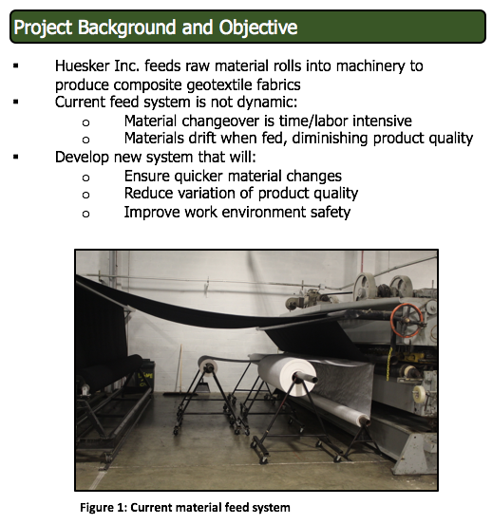
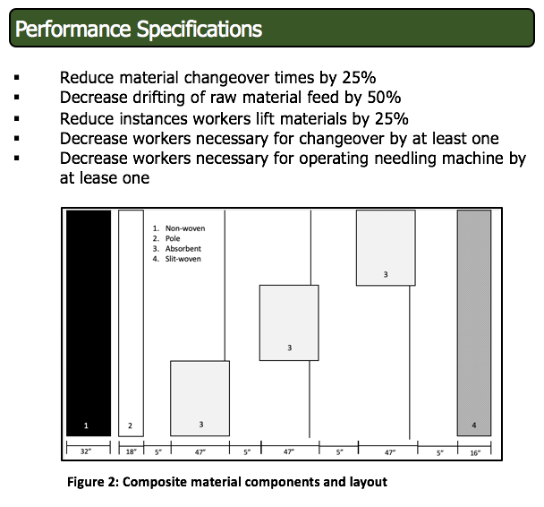
Project Background, Objective, and Performance Specifications Audio

Slide 3
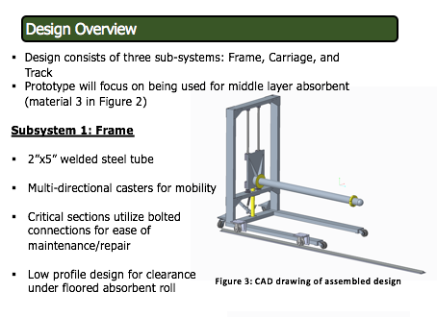
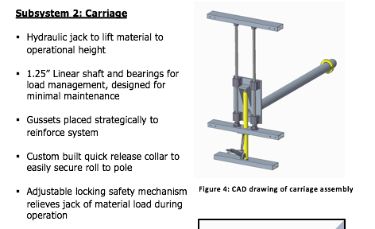
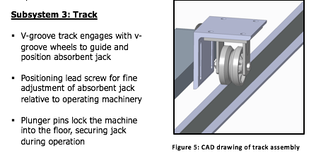
Design Introduction Audio
Subsystem 1: Frame Audio
Subsystem 2: Carriage Audio
Subsystem 3: Track Audio

Slide 4
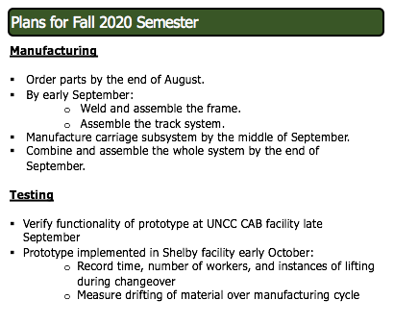
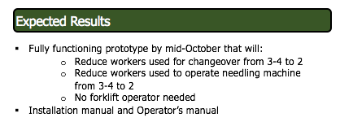
Current Progress, Plans for Fall 2020, and Expected Results Audio

