Slide 1



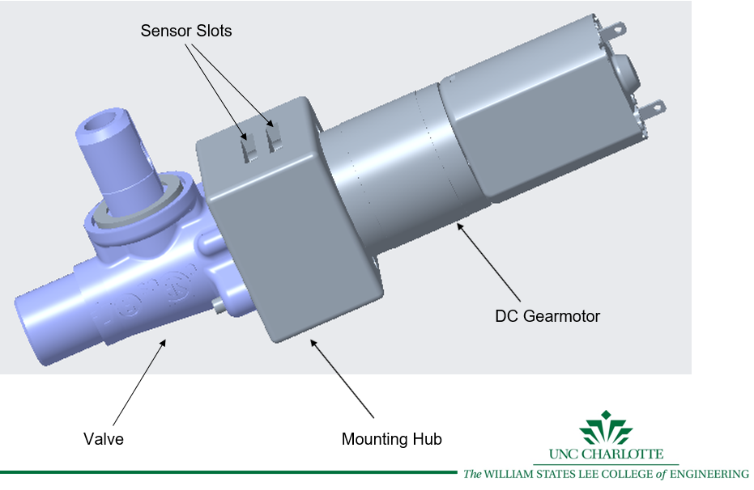
Design of an Electronic Gas Valve
ELEC_GAS - Senior Design 1 - Spring 2020
Brian Ball, Austin Greco, Rhea Lawhorn, Cameron Mahaffey, Alexis Rukundo
bball7@uncc.edu, agreco5@uncc.edu, rlawhor2@uncc.edu, cmahaff2@uncc.edu, arukundo@uncc.edu
Project Objective
Design Overview
Testing
Electrolux desires to implement an electronic gas valve into their gas range tops as well as other gas appliances
Considerations:
  Precise control and repeatability of flow
  Flow sustainable at low control settings
  Cost effective solution
Testing done to verify all prototype requirements established through project performance specifications.
Materials for testing will include pressure sensor, flow meter, compressor, and regulator
Testing will focus on durability of prototype as well as the accuracy of flow.
Project Specifications
Control System
Performance Specifications
  The valve shall have a Controllable flow coefficient in the range of 1.0e-7 ≤ C_{v} ≤ 5.0e-6 m².
  Withstand operating conditions of 60ºC.
  Turn down ratio of 35:1.
  Minimize hysteresis within ±10%
  Withstand 40000 mechanical cycles.
Device Power Rating and Dimensions
  Input voltage of 24V with power consumption of less than 5W
  5 input setting controls
  Size: less than 80x50x100mm.
  Control system allows for switch between positions at a max time of 50 ms and a minimum time of 1 second.
Cost and Safety
  Production cost of less than $10 for 10000 units produced
  Safety feature installed in the event of double component failure or power failure.
Control system is based upon PID motor control.
Position of motor will be monitored allowing for precision control of valve
LabVIEW and myRIO will be utilized as basis for control system.
Design
Mechanical Design of Valve
Actuation with DC Motor – 102 RPM Mini Econ Gear Motor
  Cost effective, simplicity, internal gearing, can be lined up to valve in series
Position sensing - Sensor Rotary 333.3 Degrees SMD
Valve - Current Electrolux Manually Controlled Valve
Mounting Hub
  Prototype 3D printed with ABS
  Recessed Screw Holes
  Tool Access for Mounting Coupler
Output Shaft
  To valve coupler
  4 mm through-hole to accommodate motor shaft
  face of coupler valve
Hold Up Capacitor
  Safety measure to close motor in event of power failure.
  Will also have an upstream solenoid valve as double safety.
Acknowledgements and References
Thank you to our Industry Supporter:
  Ryan Blanchard - Electrolux
  Victor Scarano - Electrolux
  Marshall Horne - Electrolux
  Matthew McClellan - Electrolux
Thank you to our Faculty Mentor:
  John Dunne - UNCC

Slide 2
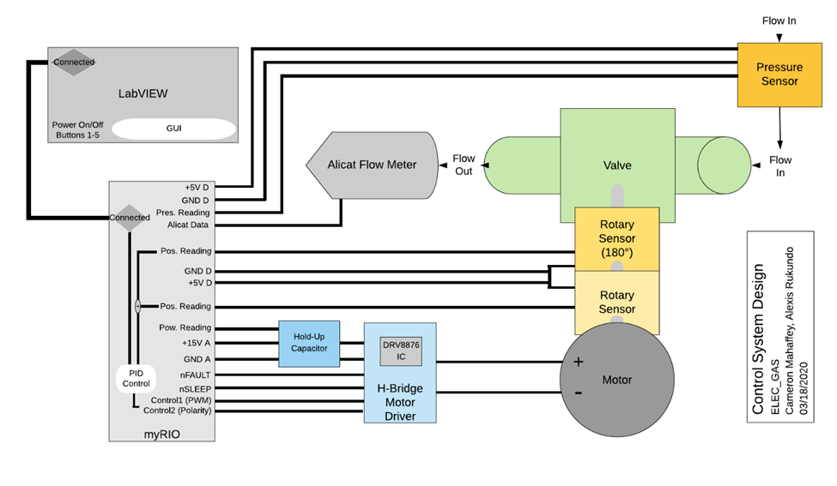
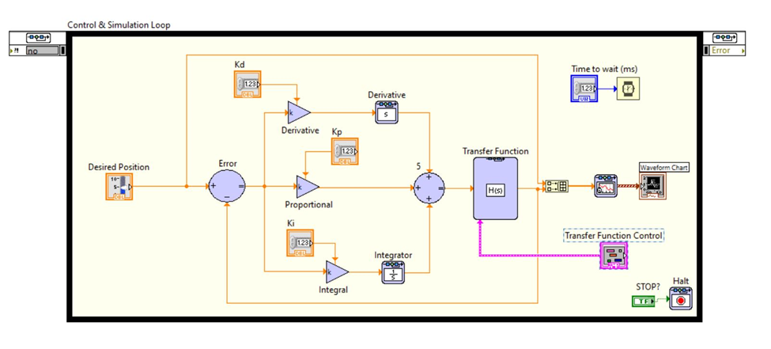
Control System

Slide 3
References
Blanchard, Ryan. “Electronic Gas Valve UNCC Senior Design Project” PowerPoint, January 13, 2020.
“Electronic gas valve initial specifications.” PDF located in google drive Revision copy B edited January 20, 2020.
“Project performance specifications.” PDF located in google drive. Revision copy B edited February 2, 2020.
“Senior Design Project Description: Design of an Electronic Gas Valve.” isl.uncc.edu. 2020. Accessed January 15, 2020. https://isl.uncc.edu/sites/isl.uncc.edu/files/media/Electrolux%20- %20Design%20of%20an%20Electronic%20Gas%20Valve.pdf

