Slide 1
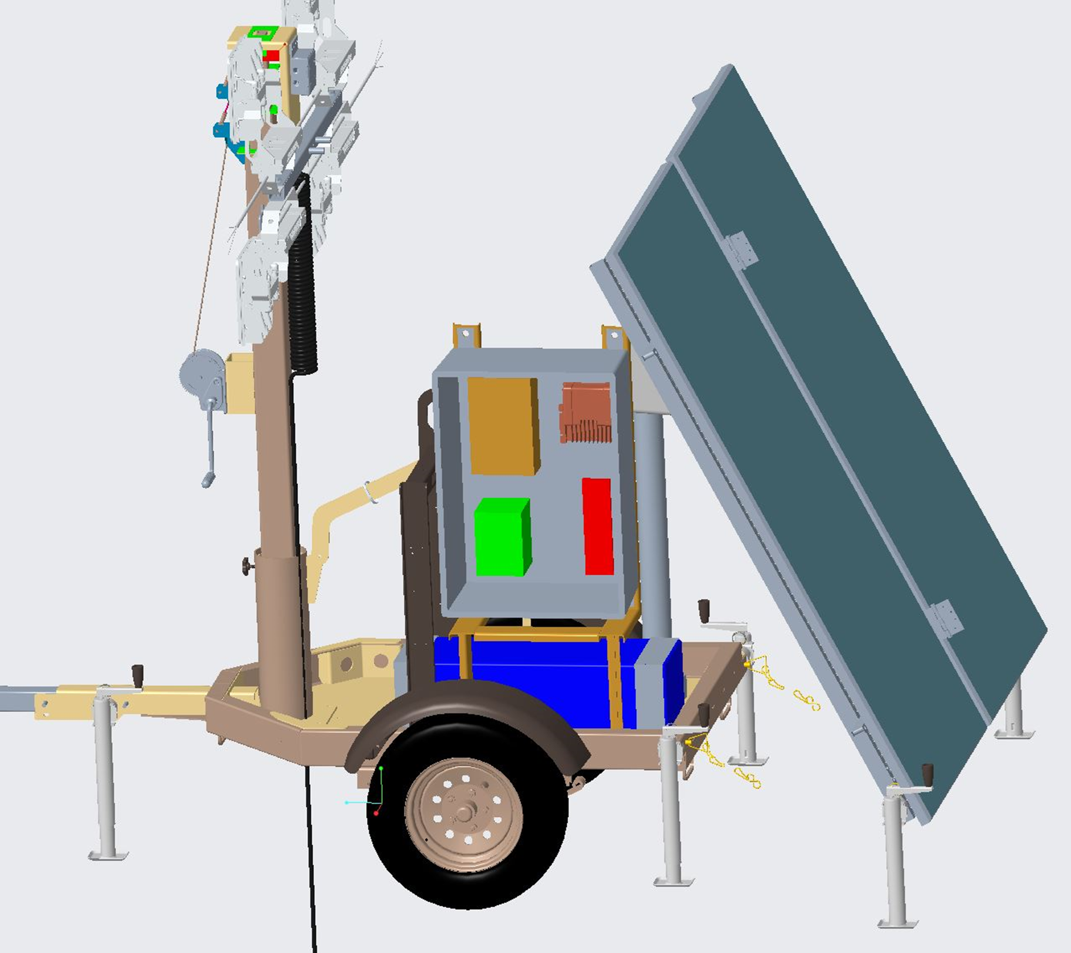
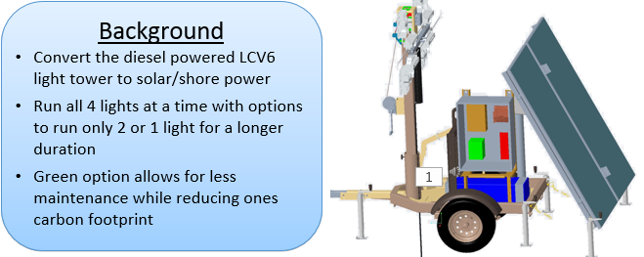
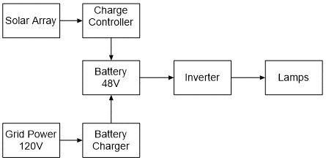
Design of a Battery Powered Solar Light Tower
Senior Design I – Spring 2020
Team Members: Lucas Shevlin lshevlin@uncc.edu, Hadair Alhawaj halhawaj@uncc.edu, Justin Andrikanich jandrika@uncc.edu,
Elijah Mateola emateola@uncc.edu, Josh Reynolds jreyno51@uncc.edu and Greg Zorn gzorn@uncc.edu
Project Support: John Dunne (mentor), Bobby Ranker and Nick Harknett (industry supporters)
Background
Convert the diesel powered LCV6 light tower to solar/shore power
Run all 4 lights at a time with options to run only 2 or 1 light for a longer duration
Green option allows for less maintenance while reducing ones carbon footprint
Challenges
Structural Failure of the lifting bracket
Battery Failure due to transit
Corrosion of metal frames and bolts
Project Requirements
Weighs less than 3,000 lbs
Less than 13’ 6” height for transportation
Operating conditions of 0 to 104 deg F
Deploy tool free with 1 person
Wind Load up to 65 mph
Operate from Grid Power
Electronic Diagram
Fall Semester Plans
08-27-20: Procurement
09-10-20: Fabrication begins
10-08-20: Initial Assembly
11-16-20: Testing
12-09-20: Presentation

Slide 2
Design of a Battery Powered Solar Light Tower
Senior Design I – Spring 2020
Team Members: Lucas Shevlin lshevlin@uncc.edu, Hadair Alhawaj halhawaj@uncc.edu, Justin Andrikanich jandrika@uncc.edu,
Elijah Mateola emateola@uncc.edu, Josh Reynolds jreyno51@uncc.edu and Greg Zorn gzorn@uncc.edu
Project Support: John Dunne (mentor), Bobby Ranker and Nick Harknett (industry supporters)
Project Requirements
Weighs less than 3,000 lbs
Less than 13’ 6” height for transportation
Operating conditions of 0 to 104 deg F
Deploy tool free with 1 person
Wind Load up to 65 mph
Operate from Grid Power

Slide 3
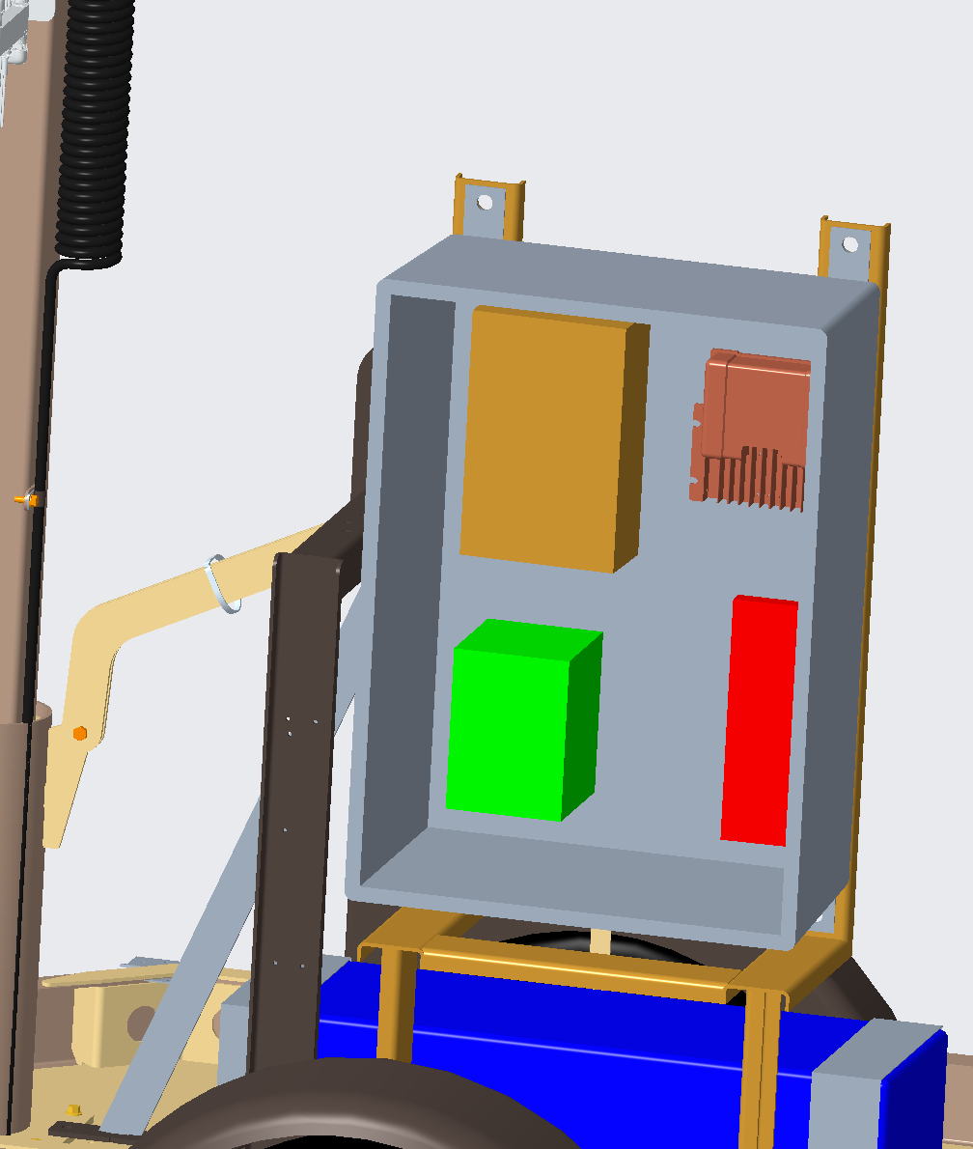
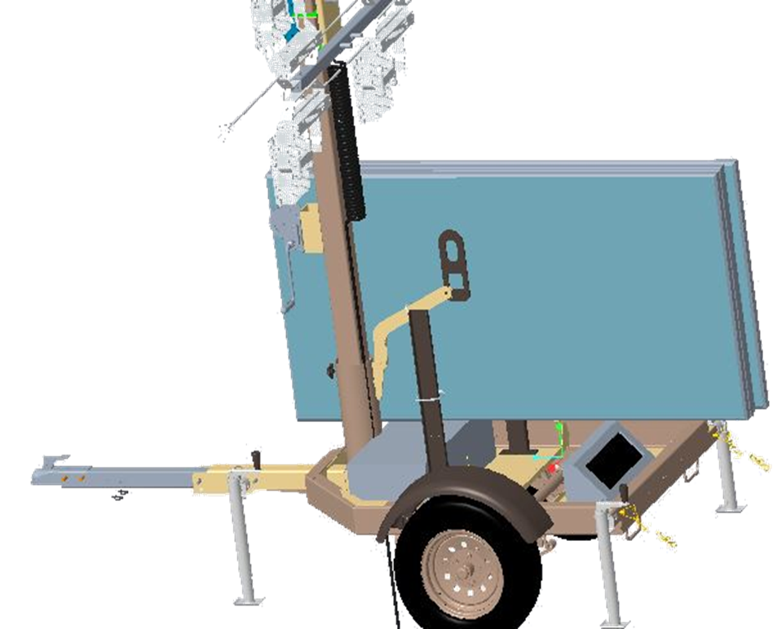
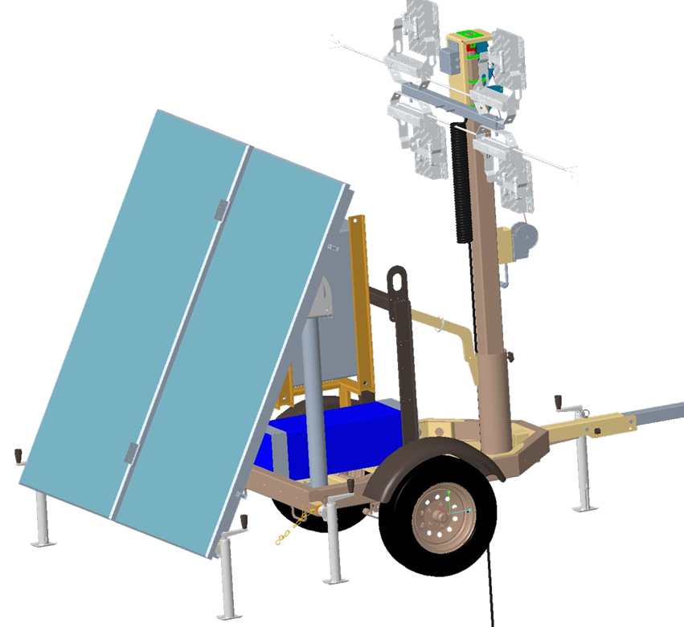
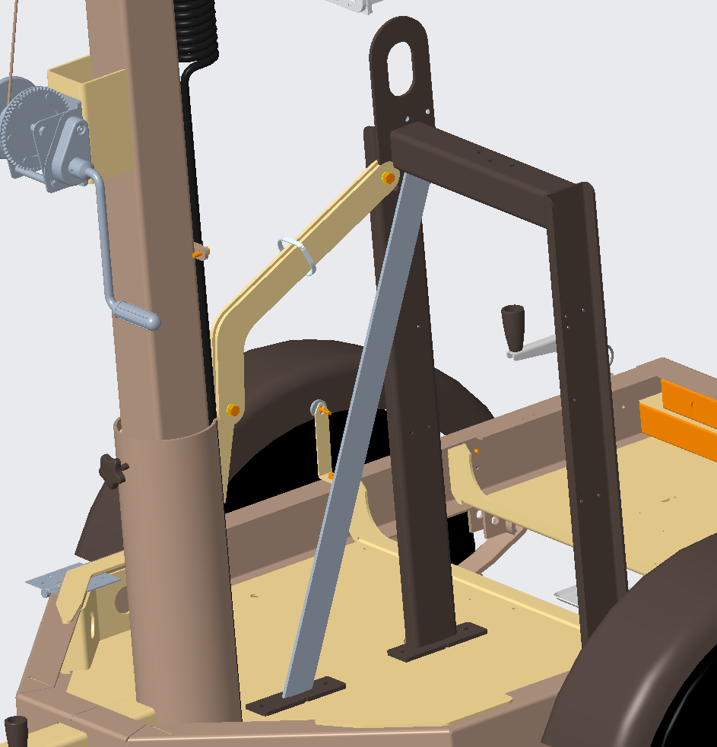
Design of a Battery Powered Solar Light Tower
Senior Design I – Spring 2020
Team Members: Lucas Shevlin lshevlin@uncc.edu, Hadair Alhawaj halhawaj@uncc.edu, Justin Andrikanich jandrika@uncc.edu,
Elijah Mateola emateola@uncc.edu, Josh Reynolds jreyno51@uncc.edu and Greg Zorn gzorn@uncc.edu
Project Support: John Dunne (mentor), Bobby Ranker and Nick Harknett (industry supporters)

Slide 4
Design of a Battery Powered Solar Light Tower
Senior Design I – Spring 2020
Team Members: Lucas Shevlin lshevlin@uncc.edu, Hadair Alhawaj halhawaj@uncc.edu, Justin Andrikanich jandrika@uncc.edu,
Elijah Mateola emateola@uncc.edu, Josh Reynolds jreyno51@uncc.edu and Greg Zorn gzorn@uncc.edu
Project Support: John Dunne (mentor), Bobby Ranker and Nick Harknett (industry supporters)

Slide 5
Design of a Battery Powered Solar Light Tower
Senior Design I – Spring 2020
Team Members: Lucas Shevlin lshevlin@uncc.edu, Hadair Alhawaj halhawaj@uncc.edu, Justin Andrikanich jandrika@uncc.edu,
Elijah Mateola emateola@uncc.edu, Josh Reynolds jreyno51@uncc.edu and Greg Zorn gzorn@uncc.edu
Project Support: John Dunne (mentor), Bobby Ranker and Nick Harknett (industry supporters)
Challenges
Structural Failure of the lifting bracket
Battery Failure due to transit
Corrosion of metal frames and bolts

Slide 6
Design of a Battery Powered Solar Light Tower
Senior Design I – Spring 2020
Team Members: Lucas Shevlin lshevlin@uncc.edu, Hadair Alhawaj halhawaj@uncc.edu, Justin Andrikanich jandrika@uncc.edu,
Elijah Mateola emateola@uncc.edu, Josh Reynolds jreyno51@uncc.edu and Greg Zorn gzorn@uncc.edu
Project Support: John Dunne (mentor), Bobby Ranker and Nick Harknett (industry supporters)
Fall Semester | 08/24 | 08/31 | 09/07 | 09/14 | 09/21 | 09/28 | 10/05 | 10/12 | 10/19 | 10/26 | 11/02 | 11/09 | 11/16 | 11/23 | 11/30 | 12/07
Procurement
Fabrication
Assembly
Testing
Final Presentation
Fall Semester | 08/24 | 08/31 | 09/07 | 09/14 | 09/21 | 09/28 | 10/05 | 10/12 | 10/19 | 10/26 | 11/02 | 11/09 | 11/16 | 11/23 | 11/30 | 12/07
Procurement
Fall Semester | 08/24 | 08/31 | 09/07 | 09/14 | 09/21 | 09/28 | 10/05 | 10/12 | 10/19 | 10/26 | 11/02 | 11/09 | 11/16 | 11/23 | 11/30 | 12/07
Procurement
Fabrication
Assembly
Fall Semester | 08/24 | 08/31 | 09/07 | 09/14 | 09/21 | 09/28 | 10/05 | 10/12 | 10/19 | 10/26 | 11/02 | 11/09 | 11/16 | 11/23 | 11/30 | 12/07
Procurement
Fabrication
Fall Semester | 08/24 | 08/31 | 09/07 | 09/14 | 09/21 | 09/28 | 10/05 | 10/12 | 10/19 | 10/26 | 11/02 | 11/09 | 11/16 | 11/23 | 11/30 | 12/07
Procurement
Fabrication
Assembly
Testing

Slide 7
Design of a Battery Powered Solar Light Tower
Senior Design I – Spring 2020
Team Members: Lucas Shevlin lshevlin@uncc.edu, Hadair Alhawaj halhawaj@uncc.edu, Justin Andrikanich jandrika@uncc.edu,
Elijah Mateola emateola@uncc.edu, Josh Reynolds jreyno51@uncc.edu and Greg Zorn gzorn@uncc.edu
Project Support: John Dunne (mentor), Bobby Ranker and Nick Harknett (industry supporters)
Background
Convert the diesel powered LCV6 light tower to solar/shore power
Run all 4 lights at a time with options to run only 2 or 1 light for a longer duration
Green option allows for less maintenance while reducing ones carbon footprint
Challenges
Structural Failure of the lifting bracket
Battery Failure due to transit
Corrosion of metal frames and bolts
Project Requirements
Weighs less than 3,000 lbs
Wind Load up to 65 mph
Less than 13’ 6” height for transportation
Operating conditions of 0 to 104 deg F
Deploy tool free with 1 person
Operate from Grid Power
Electronic Diagram
Fall Semester Plans
08-27-20: Procurement
09-10-20: Fabrication begins
10-08-20: Initial Assembly
11-16-20: Testing
12-09-20: Presentation

