Slide 1
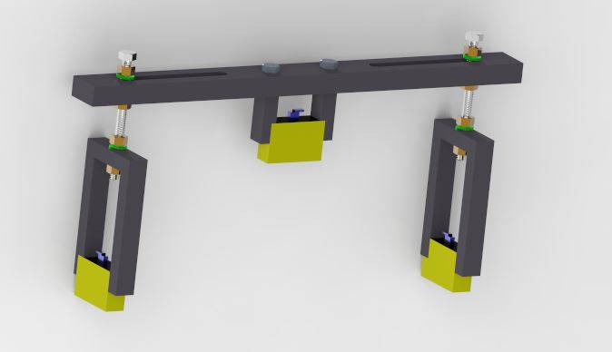
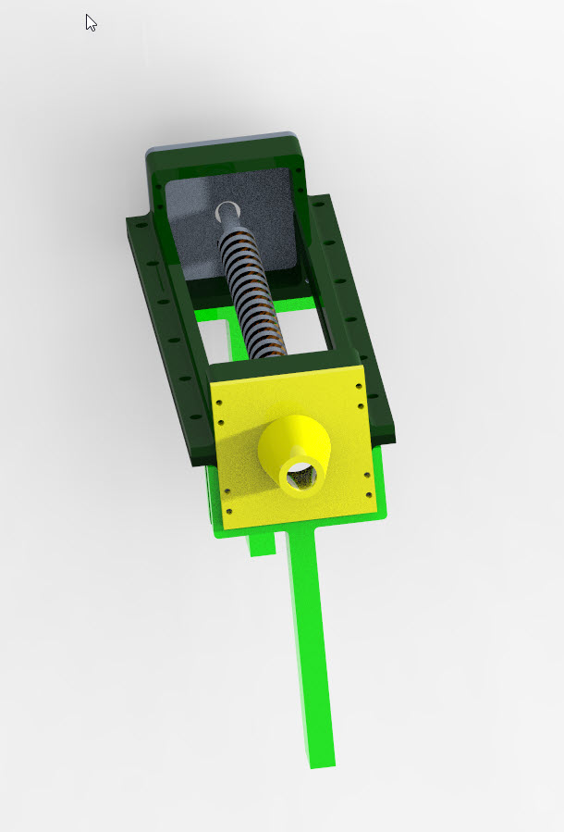
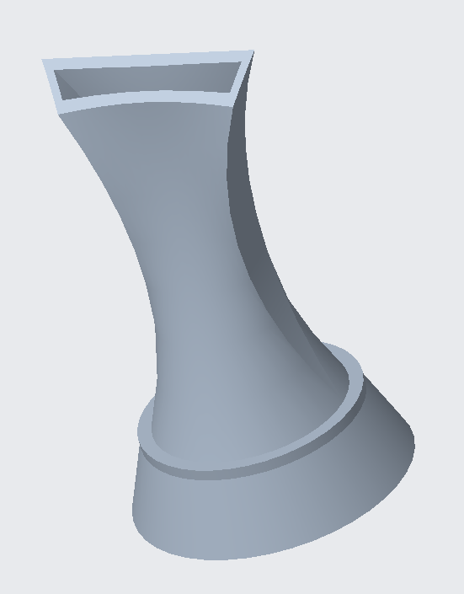
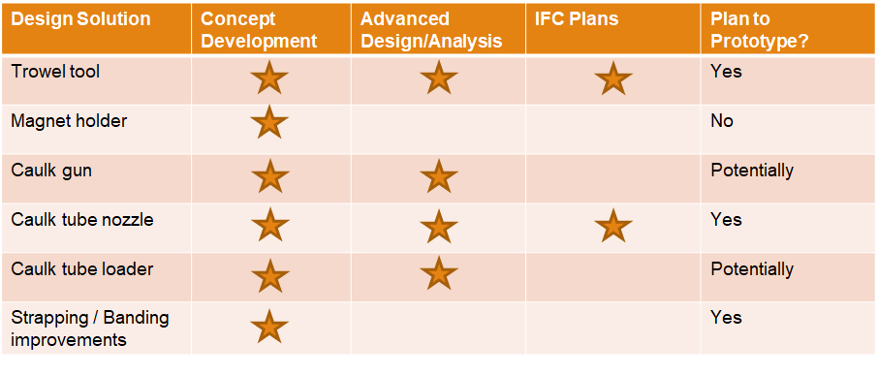
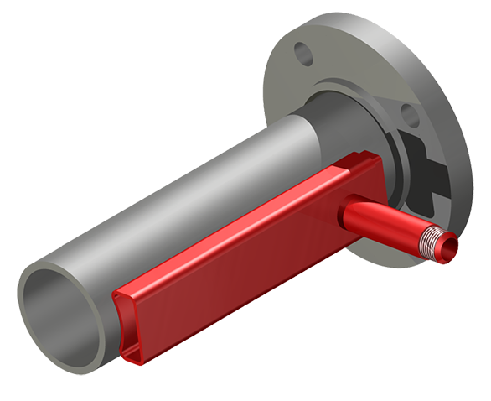
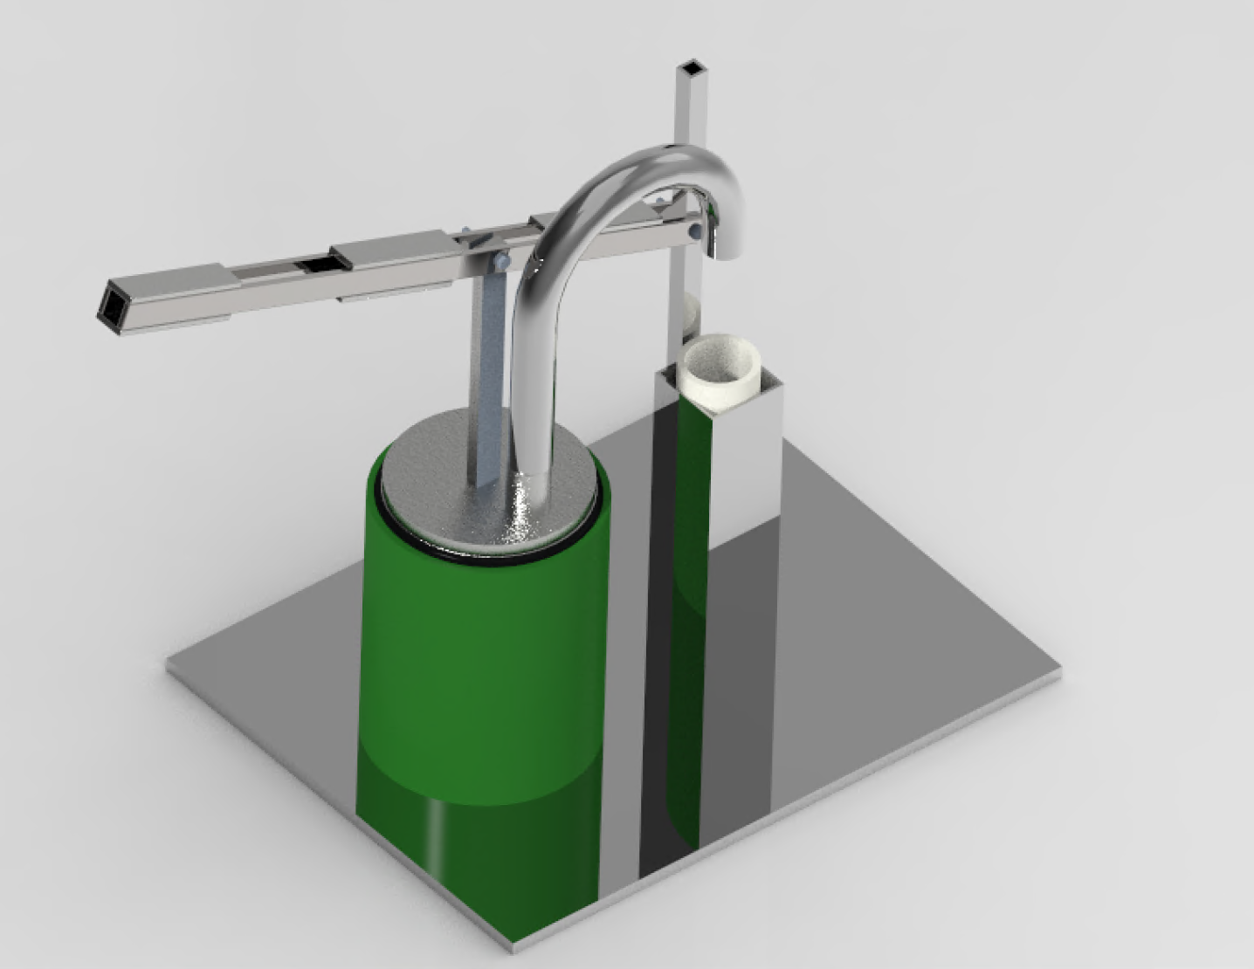
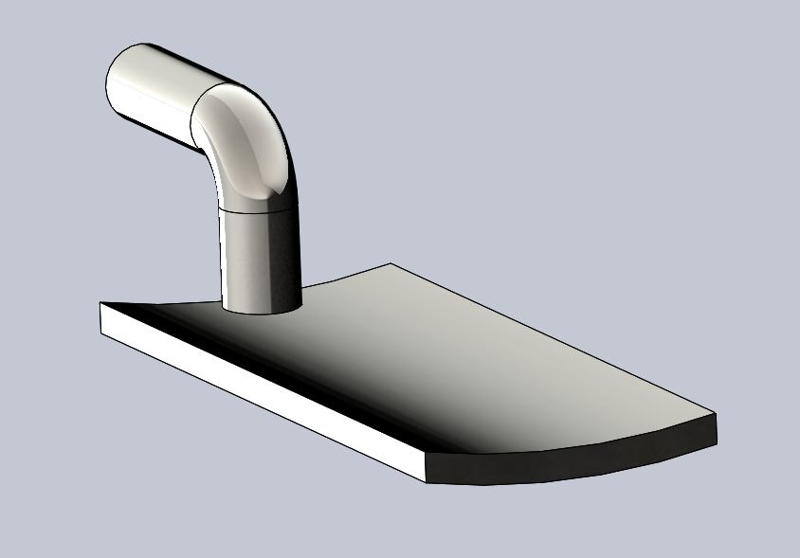
Ametek_Heat
Senior Design 1 Spring 2020
Steve Kiser Dillon Traphagen Habeeb Almatar Samir Mamoon Gabriel Brea Colton White
Overview
Designs
Current Progress
Project goal is to improve installation process for ControTrace® on various sized piping
Two Methods to Improvement
Changing the product
Changing the Installation Tools
Project is open-ended and invites creative solutions
A)
C)
B)
The Team continues to explore new ideas
The Team is preparing to prototype in the Fall
Team continues to work with Ametek and receive feedback and designs and concepts.
ControTrace®
Several Design concepts and current market solutions have been explored
D)
E)
Specifications
Plans Going Forward
Solutions will reduce the total cost of installation
Applicable solutions will be capable of providing a qualitative improvement for the field service works
Focus on scope of the installation process and not every manufacturing step involved
The Team’s Designs will address and focus on Ametek’s needs for
CT Placeholder
HTC Application
All Tools and designs will be easily understood and easy to use
Team has stopped all prototyping for Spring 2020, Prototyping will resume in Fall 2020
The Team plans to experience Multi-Panel Installation
Further research and experience will be needed for future designs
Expected Results
Several successful design that have been Prototyped and Tested
A clear improvement to Ametek’s Service workers
A) Magnetic ControTrace® Installation Placeholder designed for 1 man installation
B) HTC application gun redesigned for Ametek CSI needs and specifications
C) HTC Tube Tip designed for flat application of HTC substance
D) HTC Tube loader designed for 5 gallon buckets to fill 20 seperate 32oz tubes
E) Redesigned trowel tool to increase efficiency of HTC application

Slide 2
Overview
The goal of the project is to improve the installation process for ControTrace® on various sized piping
Two Methods to Improvement
Changing the product
Changing the Installation Tools
This project is open-ended and invites creative solutions to any aspect of CSI’s ControTrace installation procedure.
Several Design concepts and current market solutions have been explored, discussed and evaluated to best suit Ametek CSI’s needs and concerns
ControTrace®
Notes:
Dillon Traphagen

Slide 3
Specifications
Solutions will reduce the total cost of installation
Applicable solutions will be capable of providing a qualitative improvement for the field service works
Focus on scope of the installation process and not every manufacturing step involved
The Team’s Designs will address and focus on Ametek’s needs for
CT Placeholder
HTC Application
All Tools and designs will be easily understood and easy to use
Notes:
Dillon Traphagen

Slide 4
Design Descriptions
Notes:
Gabe

Slide 5
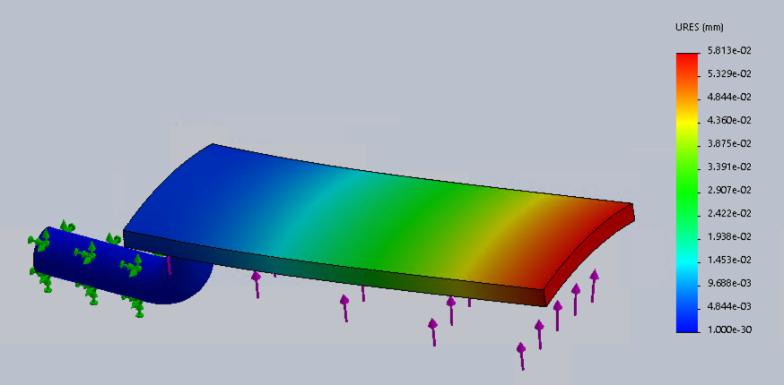
Modified Trowel Tool Description
Material is most readily available
Ease of fabrication
High yield stress
Minor Deformation
Curved Design provides easier application of HTC
Notes:
Gabe

Slide 6
Magnetic ControTrace® Installation Placeholder
Used to improve the ease of installation for the ControTrace®.
Magnets will be turned on and off
HTC will be applied to ControTrace® prior to putting onto magnet holder.
The nuts and bolts would allow the mechanism to be adjusted to fit the sizes of various pipes.
Decreases risk of incorrect ControTrace® placement and benefits product results
Notes:
Colton

Slide 7
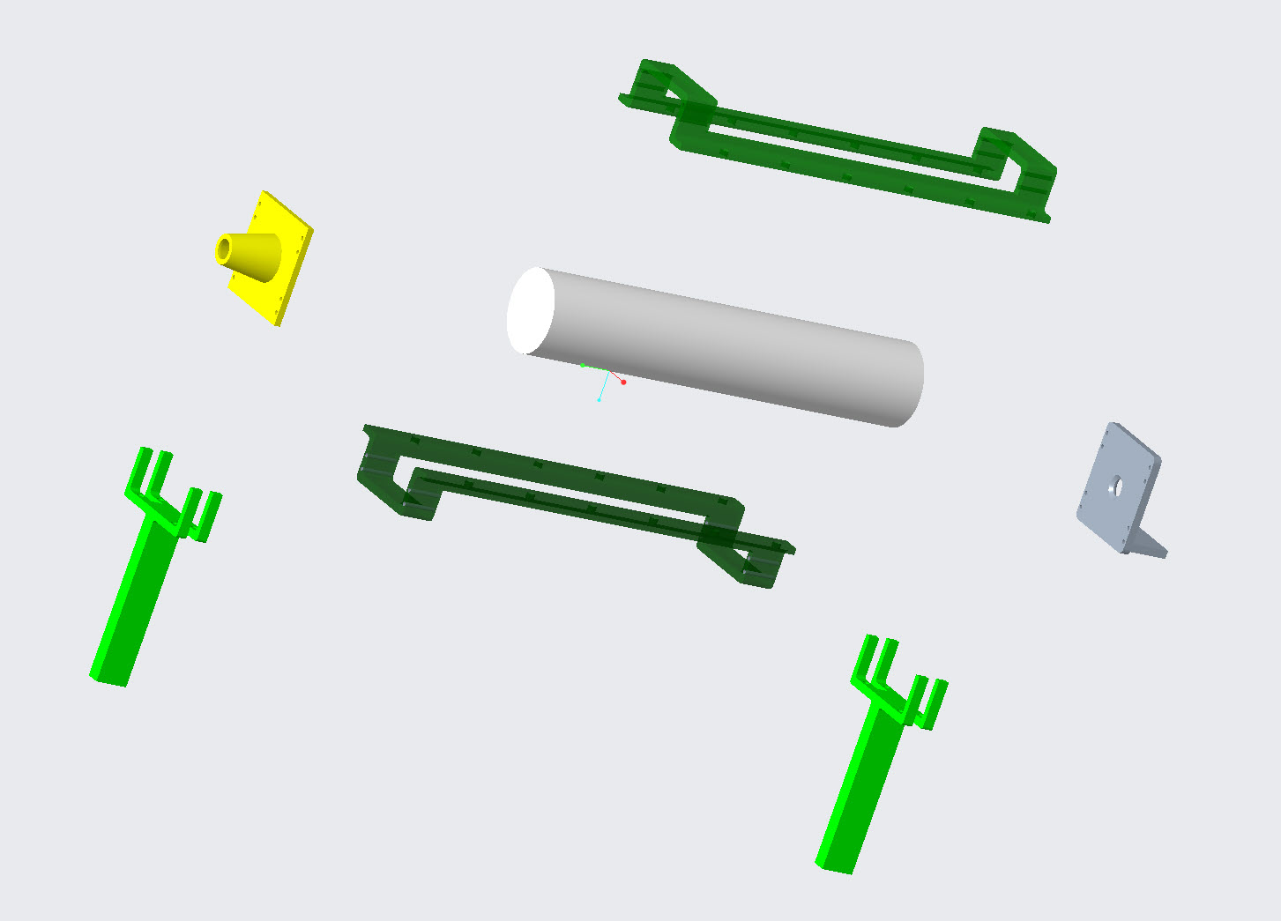
Caulk Gun Design
The Team has designed two variations of an electric caulk gun
The caulk gun utilizes a 1/16 HP 12 VDC motor (MTGP-P06-1J008)
Team would design and manufacture the caulk gun as an Alternative method for HTC Application
Notes:
Habeeb

Slide 8
Caulk Tube Nozzle Attachment
The attachment can click fit both diameters of HTC caulk tube
The opening thickness is less than
the maximum 1/8th inch
Due to funneled design, the opening will be able to have the HTC flow smoothly out
Notes:
Samir

Slide 9
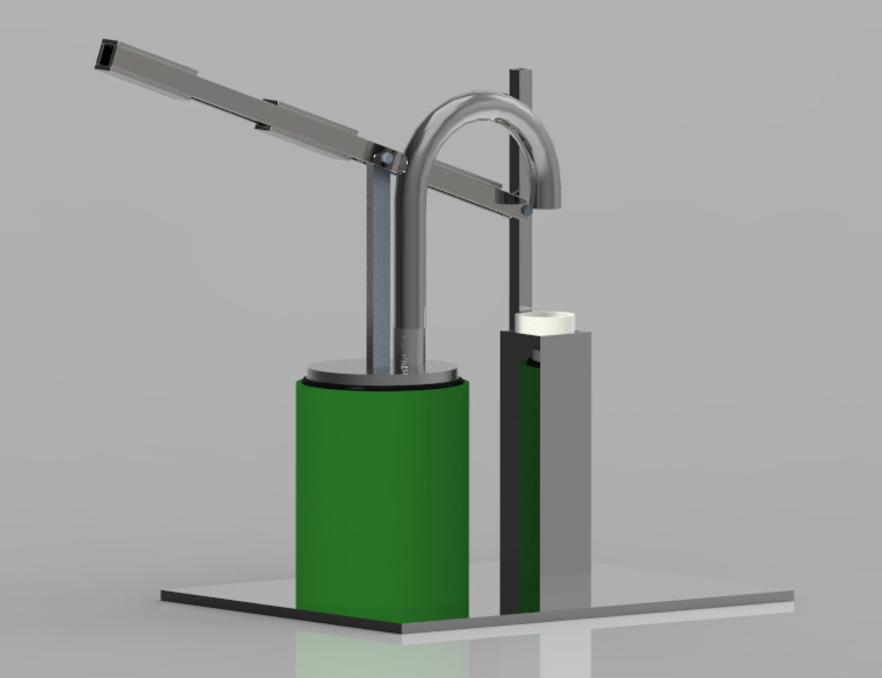
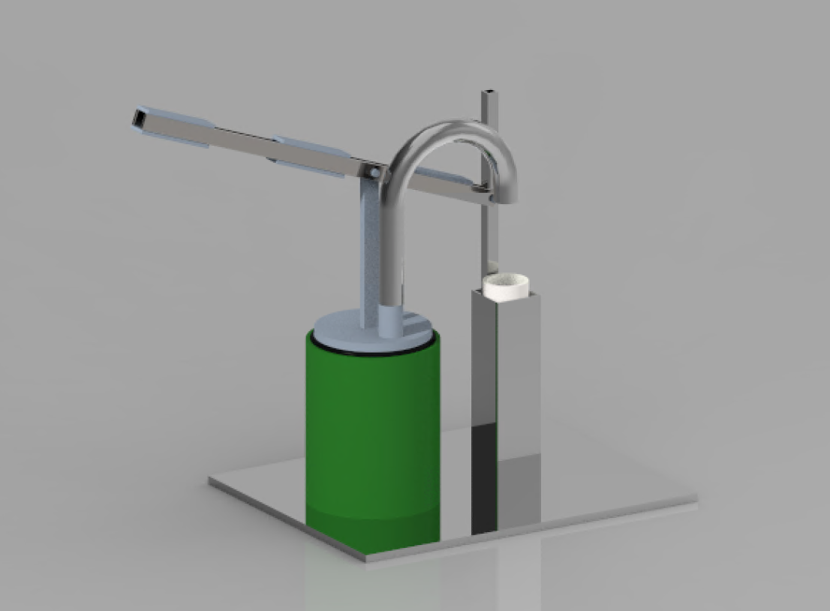
Caulk Tube Loader Description
20 (32 oz) tubes of HTC = 5 Gallon of HTC
About 75 feet per gallon of HTC.
Self-Filling Tubes would be cost efficient.
Buying in bulk could reduce price per tube.
Additions: More support added on handle, caulk tube holder placement was repositioned.
Handle
Caulk Tube
HTC 5 Gallon
Notes:
Colton

Slide 10
Current Progress
The Team continues to explore Strapping/Banding Alternatives for Ametek
The Team is finishing final designs and are preparing to prototype in the Fall
Team continues to work with Ametek and receive feedback and designs and concepts
Notes:
Samir

Slide 11
Plans Going Forward
Team has stopped all prototyping for Spring 2020, Prototyping will resume in Fall 2020
The Team plans to experience Multi-Panel Installation
Further research and experience will be needed for future designs
Expected Results
Several successful design that have been Prototyped and Tested
A clear improvement to Ametek’s Service workers
Notes:
Dillon

