Slide 1
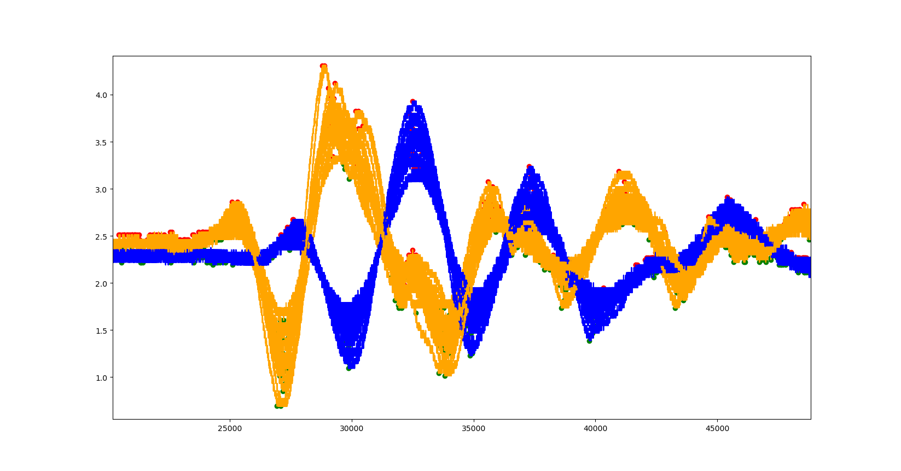
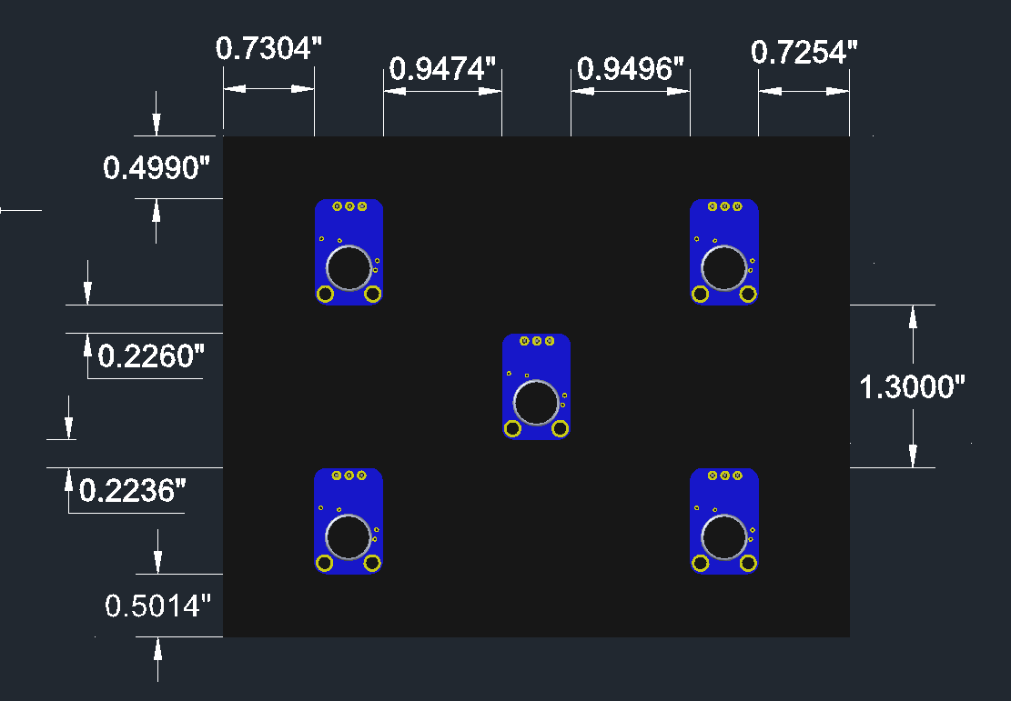
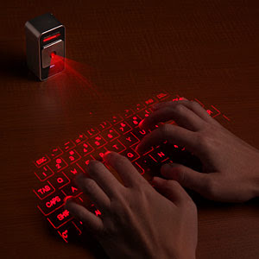
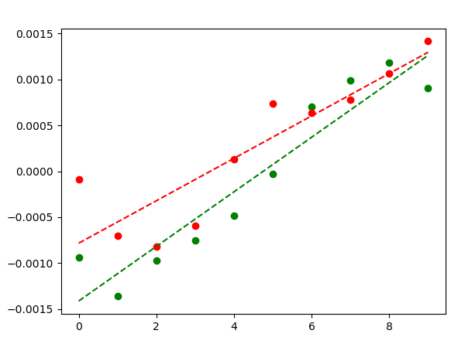
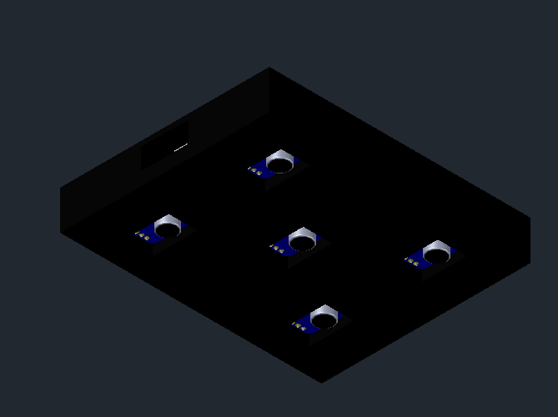
UNCC_Keyboard
Virtual Keyboard Based on Vibration Localization
Senior Design I - Spring 2020
Objective
Fall 2020 Semester
The students in this project were tasked to design a virtual keyboard, which works by appropriately placing at least three sensors to detect the tapping location and translate that tap into a virtual key press. The primary objective of this group is to design a virtual keyboard that will accurately determine the distance of a tap from the sensors and translate the value into an input command for an electronic device using triangulation.
Software Analysis
Hardware Design
Verify the exact spatial resolution of tap locations.
Collect and analyze the different microphone spacing options available based on spatial resolution.
Determine the most optimal configuration or allocation of microcontroller(s).
Design circuit and order PCB.
Further develop the microprocessor firmware to locate a tap location with varying microphone locations.
Construct a rough prototype and test functionality within the case for any outstanding design errors.
Finalize prototype and add any features that could be deemed to increase product functionality/versatility.
To generate simple data samples, the area was split into 10 1-inch sections and 20-25 samples were taken at each location.
Data was collected by outputting oscilloscope readings to a CSV file.
An analysis software was developed using Python to analyze the data stored within CSV files.
An example of the collected data after analysis can be seen below in Figure 2 and Figure 3.
Figure 2 consists of overlapping the results of the 20 data collections to locate local minimums and maximums.
Figure 3 shows the average of the calculated time differences and their resulting line of best fit.
Hardware designed using Autodesk AutoCAD 2020.
Two prototypes designed: "Hinged" and "Hingeless".
Each prototype used the following:
A PLA filament 3D printed shell.
Five (5) MAX4466 microphone sensors.
A micro-USB female connection port.
“X” formation to ensure triangulation.
The "Hinged" design includes three (3) block sections, each connected by hinges, separating the microphones at approximately 4.5".
The "Hingeless" design includes one (1) block section, separating the microphones at an approximate distance of .95".
The “Hingeless" design was chosen for the final product.
Project Specifications
Prototype a sensor sub-system in order to detect a tapping input.
This developed prototype must utilize multiple microphone sensors in order to determine a triangulation.
Software to read the detected tapping input and triangulate the location.
Demonstration of the working software on a hardware system that displays the working process of the microphone signal.
Conclusion
Software analysis has been fully designed and tested using both Python and the collected data. However, this software can still be optimized.
While the hardware and case have been simulated and rendered respectively, as further testing and analysis give promising results, these designs are still expected to change
The current prototype in development relies on the use of an Arduino Uno as the microcontroller, however this may be replaced with another microcontroller or series of microcontrollers to help optimize the performance on the prototype.
While some unforeseen circumstances and errors occurred during this data collection process, reliable data was still able to yield promising results.
Unless unforeseen circumstances arise, the first prototype is expected to be fully designed and tested to only test the current layout. Once this has been verified, further testing will be done to translate results into final product.
Simulations
Figure 2: Left Vs Right Signal
Figure 4: Designed Box Sensors [2]
Figure 1: A typical virtual keyboard [1]
Complete Status
References
The analysis software has been written and thoroughly tested, however it is still being optimized.
A prototype using an Arduino has been designed but is still being further developed.
AutoCad renderings of the final case have been designed, however this may change as further testing is completed.
The predicted spatial resolution has been estimated to roughly 3-4 ms, however this value is still being verified through newly collected data.
[1] “Cube Laser Virtual Keyboard for Your IPhone, PC or IPad.” Cube Laser Virtual Keyboard for your iPhone, PC or iPad. MrTechpathi, August 17, 2011. http://www.mrtechpathi.com/2011/08/cube-laser-virtual-keyboard-for-your.html
[2] “Adafruit Max4466 Module.” Free CAD Designs, Files & 3D Models | The GrabCAD Community Library. Alexei Kositsin, November 1, 2019. https://grabcad.com/library/adafruit-max4466-module-1
Figure 3: Max & Min Time-Differential
Figure 5: Designed Box Sensors
Project Team Members: Jasem Alawadhi (EE) jalawadh@uncc.edu | William Braxton (EE) wbraxton@uncc.edu | Trevor Fitzwater (CpE) tfitzwa1@uncc.edu | Michael Norris (EE/CpE) mnorri25@uncc.edu
Faculty Mentor: Dr. Jeremy Holleman

Slide 2
Objectives
Project Specifications
The students in this project were tasked to design a virtual keyboard, which works by appropriately placing at least three sensors to detect the tapping location and translate that tap into a virtual key press. The primary objective of this group is to design a virtual keyboard that will accurately determine the distance of a tap from the sensors and translate the value into an input command for an electronic device using triangulation.
Prototype a sensor sub-system in order to detect a tapping input.
This developed prototype must utilize multiple microphone sensors in order to determine a triangulation.
Software to read the detected tapping input and triangulate the location.
Demonstration of the working software on a hardware system that displays the working process of the microphone signal.
Figure 1: A typical virtual keyboard [1]

Slide 3
Software Analysis
Simulations
To generate simple data samples, the area was split into 10 1-inch sections and 20-25 samples were taken at each location.
Data was collected by outputting oscilloscope readings to a CSV file.
An analysis software was developed using Python to analyze the data stored within CSV files.
An example of the collected data after analysis can be seen below in Figure 2 and Figure 3.
Figure 2 consists of overlapping the results of the 20 data collections to locate local minimums and maximums.
Figure 3 shows the average of the calculated time differences and their resulting line of best fit.
Figure 2: Left Vs Right Signal
Figure 3: Max & Min Time-Differential

Slide 4
Hardware Design
Complete Status
Hardware designed using Autodesk AutoCAD 2020.
Two prototypes designed: "Hinged" and "Hingeless".
Each prototype used the following:
A PLA filament 3D printed shell.
Five (5) MAX4466 microphone sensors.
A micro-USB female connection port.
“X” formation to ensure triangulation.
The "Hinged" design includes three (3) block sections, each connected by hinges, separating the microphones at approximately 4.5".
The "Hingeless" design includes one (1) block section, separating the microphones at an approximate distance of .95".
The “Hingeless" design was chosen for the final product.
The analysis software has been written and thoroughly tested, however it is still being optimized.
A prototype using an Arduino has been designed but is still being further developed.
AutoCad renderings of the final case have been designed, however this may change as further testing is completed.
The predicted spatial resolution has been estimated to roughly 3-4 ms, however this value is still being verified through newly collected data.
Figure 4: Designed Box Sensors
Figure 5: Designed Box Sensors
Notes:
For the designed hardware of our project, AutoCAD 2020 allowed us to create two different prototype designs. These prototypes, in order to complete our project specifications effectively, must house five of the microphone sensors in a formation (the “x” formation) to properly allow for the tap to be triangulated. The prototype must also include a way to communicate with the code in order to display

Slide 5
Fall 2020 Semester
Conclusions
Verify the exact spatial resolution of tap locations.
Collect and analyze the different microphone spacing options available based on spatial resolution.
Determine the most optimal configuration or allocation of microcontroller(s).
Design circuit and order PCB.
Further develop the microprocessor firmware to locate a tap location with varying microphone locations.
Construct a rough prototype and test functionality within the case for any outstanding design errors.
Finalize prototype and add any features that could be deemed to increase product functionality/versatility.
Software analysis has been fully designed and tested using both Python and the collected data. However, this software can still be optimized.
While the hardware and case have been simulated and rendered respectively, as further testing and analysis give promising results, these designs are still expected to change
The current prototype in development relies on the use of an Arduino Uno as the microcontroller, however this may be replaced with another microcontroller or series of microcontrollers to help optimize the performance on the prototype.
While some unforeseen circumstances and errors occurred during this data collection process, reliable data was still able to yield promising results.
Unless unforeseen circumstances arise, the first prototype is expected to be fully designed and tested to only test the current layout. Once this has been verified, further testing will be done to translate results into final product.

