Slide 1
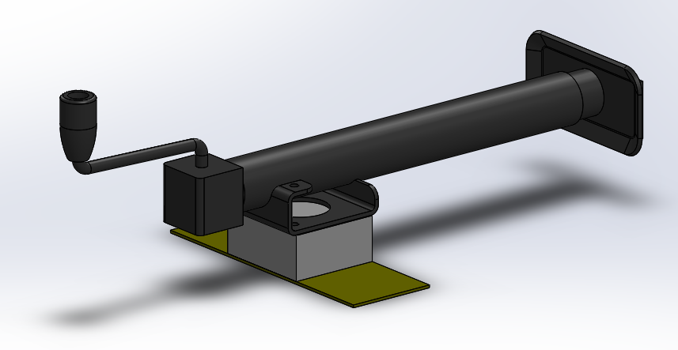
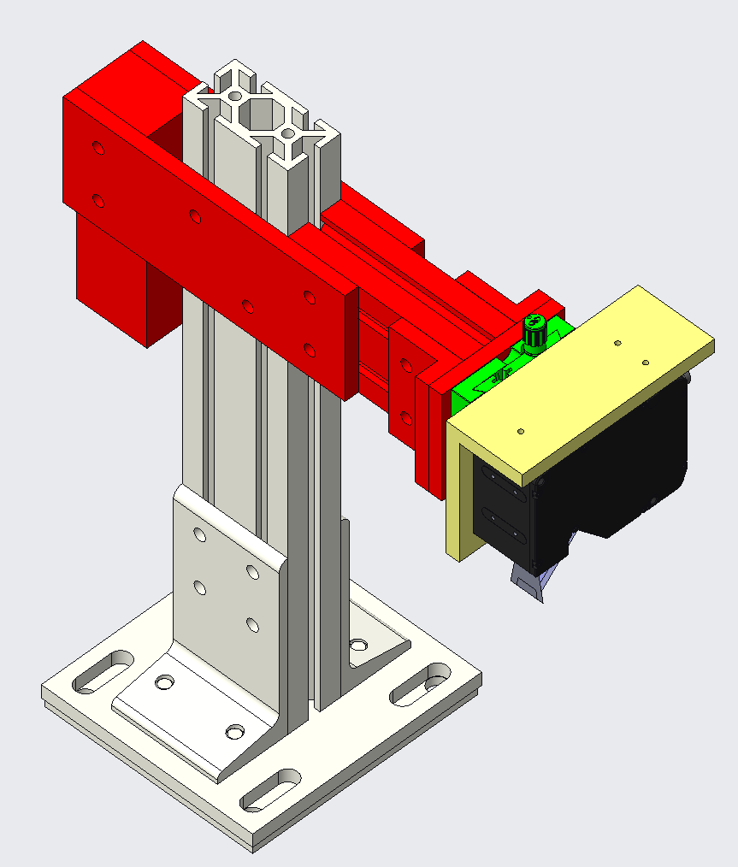
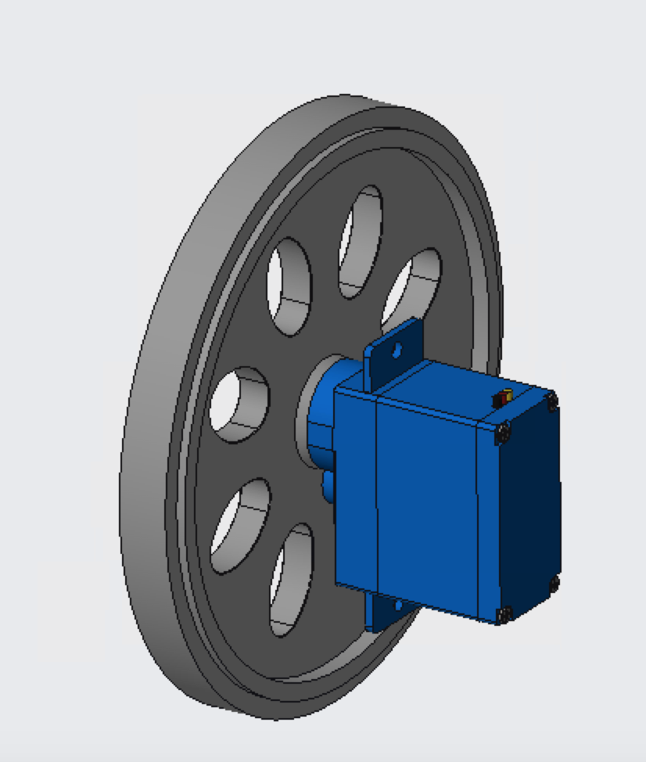
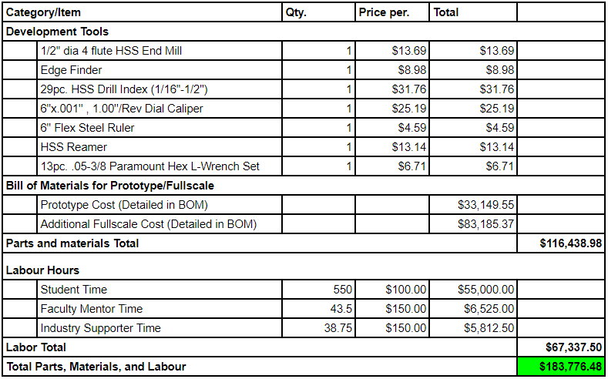
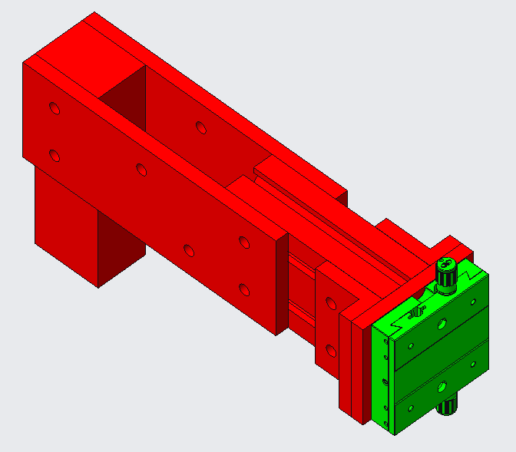
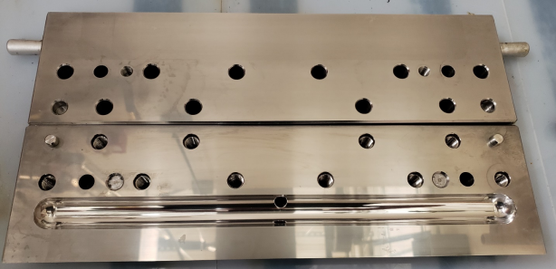
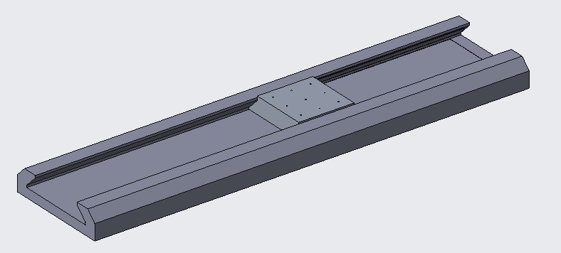
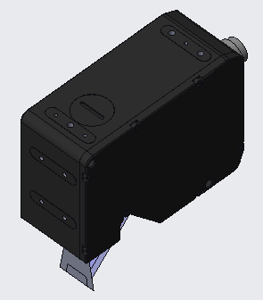
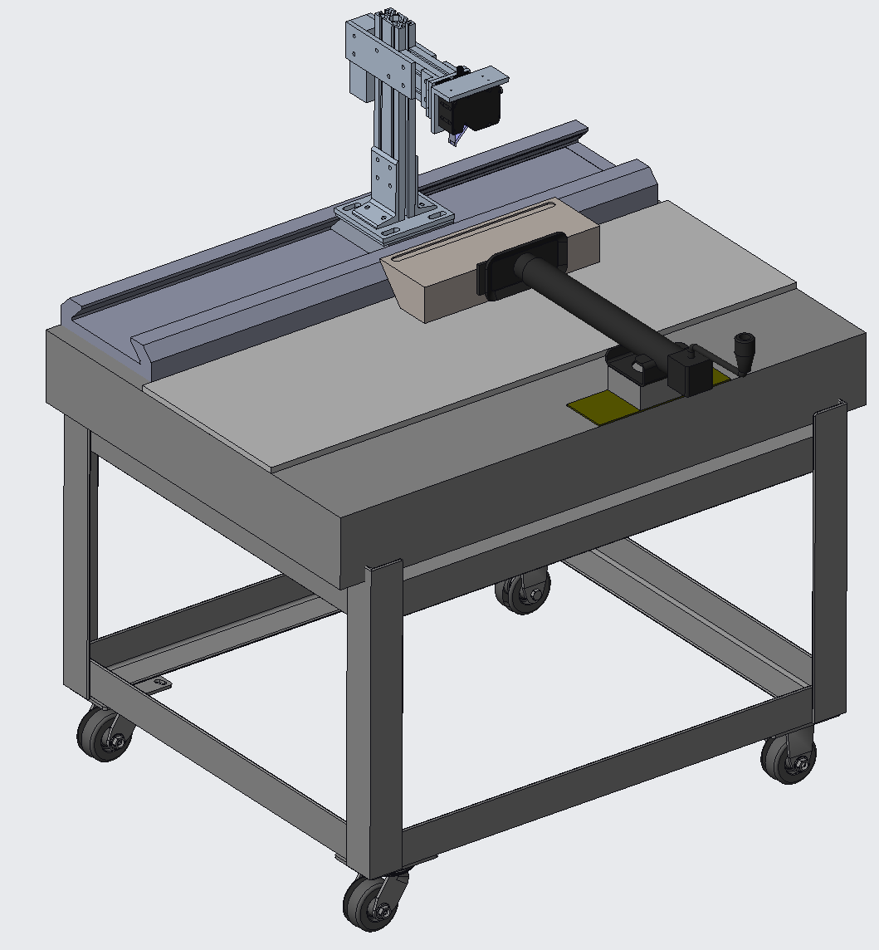
Development of Precision Measurement Device for Coating Dies
Senior Design 1 - Spring 2020 - TC_COAT
Team Members: Richard Boatwright (rboatwr3@uncc.edu), Matthew Thornton (mthorn19@uncc.edu),
Ethan Bryant (ebryan13@uncc.edu), Lingxuan Hao (lhao1@uncc.edu),
Faculty Mentor/Industry Supporters: Dr. Edward Morse / Mike Carter, Ali Vignola
Problem Statement
Subassemblies
Budget Overview
Design a user friendly, high precision metrological system
Used to measure and record slot die land flatness
2.5 um measurement resolution
Provide a Return on Investment Analysis
Provide a User Manual
Figure 1:
Budget overview of cost of the project with full Sponsor funding.
Suggested option
Most expensive
U-Series Rail
Price to build Prototype AND Full-scale shown
Only Prototype will be built by Team
Slot Die Background
Used device for coating applications
Consist of two halves
The land and lip flatness are particularly sensitive areas
Variation in flatness can occur through misuse, accidents, and/or wear
A solution that reduces these costs would be a great benefit to TC
Secondary option: Limited to University provided budget of $3000
The Linear Motion System and Optical Sensor would be changed to fit within new budget parameters.
Tertiary option: Replace OAV U-series LMS system with OAV Dovetail
Budget reduced by:
17% for Prototype
78.5% for Full-scale Budget
DPS: The Die Positioning System moves the Die into measurement range.
Uses a Hitch-Jack as a purchasable actuator
Utilizes clamps to secure sub-assembly
Avoids permanent modification of granite table
Teflon surface for low friction
Frame: The Interface between the LMS and the Sensor.
Includes the LAS, VPS, and several mounts
Made from extruded T-channel aluminum, T-channel hardware, and milled parts
Counter balanced
Vertically adjustable
VPS: The Vertical Positioning System allows for focusing the sensor within its measurement range.
Fine adjustment by M-TSX-1D Single Direction Stage by MKS
Coarse adjustment by loosening T-slot bolts
Counterweight doubles as handle
LAS: The Linear Actuation System provides the automated movement and linear encoding.
Encoding is magnetic and sent to the sensor system (not pictured)
Movement is a simple servo and wheel
Will be altered if inaccurate or induces vibrations in testing
Future Work
Figure 1:
Image of 16-inch slot die to be tested on our designed prototype metrology system
Summer
Purchasing of parts
Fabrication of prototype
Refinement
Assembly Troubleshooting
Senior Design 2 (Fall 2020)
Testing of the prototype
System Optimization
Documentation Packet
User Manual
Return on Investment Analysis
Specifications/Requirements
Critical Subassemblies
Performance Specifications
2.5 Micrometers of resolution
Accommodate 8 - 66-inch dies, four to seven inches in depth, and one to seven inches in height
Profitable ROI for Transcontinental
Requirements
All documents must be in PDF format
All CAD performed in Creo or Solidworks
Built solution must include technical documentation such as a user manual for training purposes.
Any metrological process used should minimize risk of damage or wear to the die.
Output of the measurement process should be easy to record and review, Excel is preferred.
The flatness of the land of each die half should be measurable. Any other measurements, such as the lip of the die, is optional.
The device should fit on a pre-existing marble table located at Transcontinental’s part inspection station.
The device should be considered to be non-portable.
The process should be cheaper and quicker than the current outsourcing.
A preliminary product user manual will be developed for the prototype.
Full Assembly
Summer
Purchasing of parts
Fabrication of prototype
Refinement
Assembly Troubleshooting
Senior Design 2 (Fall)
Testing of the prototype
Optimization
Documentation Packet
User Manual
Return on Investment Analysis
Granite table creates stable metrology base
This shows how the die would be positioned
Not pictured:
air fitting and hoses
power/data cables
encoder system
sensor controllers
These parts will be fitted during assembly
LMS length is not to scale
LMS: The Linear Motion System allows for smooth continuous motion of the frame across the die
Frame mounts to the top of the carriage
Consist of an Air slide from OAV
Uses air for stability and accuracy
Why is it critical? - Constrains the sensors motion to a plane parallel to die surface
Sensor: The sensor will take measurements of the surface to analyze elevation variance
Measures the flatness of the die surface
Measured with laser interferometry
0.3um Repeatability and 2.2um Linearity
Software auto aligns measurements
Why is it critical? - Its resolution is the smallest increment that can possibly be measured
Notes:
Richard:
Hello, My name is Richard Boatwright and I am the Project Leader of project short name TC_COAT, tasked with development of a precision measurement device for Transcontinental Advanced coatings.

Slide 2
Development of Precision Measurement Device for Coating Dies
Senior Design 1 - Spring 2020 - TC_COAT
Team Members: Richard Boatwright (rboatwr3@uncc.edu), Matthew Thornton (mthorn19@uncc.edu),
Ethan Bryant (ebryan13@uncc.edu), Lingxuan Hao (lhao1@uncc.edu),
Faculty Mentor/Industry Supporters: Dr. Edward Morse / Mike Carter, Ali Vignola
Problem Statement
Design a user friendly, high precision metrological system
Used to measure and record slot die land flatness
2.5 um measurement resolution
Provide a Return on Investment Analysis
Provide a User Manual
Summer
Purchasing of parts
Fabrication of prototype
Refinement
Assembly Troubleshooting
Senior Design 2 (Fall)
Testing of the prototype
Optimization
Documentation Packet
User Manual
Return on Investment Analysis
Notes:
Richard:
Our team was asked to design a device capable of resolving as close to 2.5um in flatness deviation of a slot dies surface as possible, and to analyze how much money this could potentially save their company long term as well as keep the entry level operators in mind by producing a user friendly device with a comprehensive user manual.

Slide 3
Development of Precision Measurement Device for Coating Dies
Senior Design 1 - Spring 2020 - TC_COAT
Team Members: Richard Boatwright (rboatwr3@uncc.edu), Matthew Thornton (mthorn19@uncc.edu),
Ethan Bryant (ebryan13@uncc.edu), Lingxuan Hao (lhao1@uncc.edu),
Faculty Mentor/Industry Supporters: Dr. Edward Morse / Mike Carter, Ali Vignola
Problem Statement
Design a user friendly, high precision metrological system
Used to measure and record slot die land flatness
2.5 um measurement resolution
Provide a Return on Investment Analysis
Provide a User Manual
Slot Die Background
Used device for coating applications
Consist of two halves
The land and lip flatness are particularly sensitive areas
Variation in flatness can occur through misuse, accidents, and/or wear
A solution that reduces these costs would be a great benefit to TC
Image of 16 inch slot die to be tested on our designed prototype metrology system
Summer
Purchasing of parts
Fabrication of prototype
Refinement
Assembly Troubleshooting
Senior Design 2 (Fall)
Testing of the prototype
Optimization
Documentation Packet
User Manual
Return on Investment Analysis
Notes:
Richard:
The reason why slot die flatness is so important is because coating applications are often only a few micrometers in thickness,
therefore small deviations in the gap width between the slot die lips can produce product that is out of spec.
This damage can occur due to operator mishandling, wear, or accidents.

Slide 4
Development of Precision Measurement Device for Coating Dies
Senior Design 1 - Spring 2020 - TC_COAT
Team Members: Richard Boatwright (rboatwr3@uncc.edu), Matthew Thornton (mthorn19@uncc.edu),
Ethan Bryant (ebryan13@uncc.edu), Lingxuan Hao (lhao1@uncc.edu),
Faculty Mentor/Industry Supporters: Dr. Edward Morse / Mike Carter, Ali Vignola
Problem Statement
Design a user friendly, high precision metrological system
Used to measure and record slot die land flatness
2.5 um measurement resolution
Provide a Return on Investment Analysis
Provide a User Manual
Slot Die Background
Used device for coating applications
Consist of two halves
The land and lip flatness are particularly sensitive areas
Variation in flatness can occur through misuse, accidents, and/or wear
A solution that reduces these costs would be a great benefit to TC
Image of 16-inch slot die to be tested on our designed prototype metrology system
Specifications/Requirements
Performance Specifications
2.5 Micrometers of resolution
Accommodate 8 - 66-inch dies, four to seven inches in depth, and one to seven inches in height
Profitable ROI for Transcontinental
Requirements
All documents must be in PDF format
All CAD performed in Creo or Solidworks
Built solution must include technical documentation such as a user manual for training purposes.
Any metrological process used should minimize risk of damage or wear to the die.
Output of the measurement process should be easy to record and review, Excel is preferred.
The flatness of the land of each die half should be measurable. Any other measurements, such as the lip of the die, is optional.
The device should fit on a pre-existing marble table located at Transcontinental’s part inspection station.
The device should be considered to be non-portable.
The process should be cheaper and quicker than the current outsourcing.
A preliminary product user manual will be developed for the prototype.
Summer
Purchasing of parts
Fabrication of prototype
Refinement
Assembly Troubleshooting
Senior Design 2 (Fall)
Testing of the prototype
Optimization
Documentation Packet
User Manual
Return on Investment Analysis
Notes:
Richard:
So this projects requirements come down to the following main points.
Our supporter needs as close to 2.5 micrometers resolution as possible.
The prototype must be scalable to accommodate a wide range of die sizes.
and it must produce a measurable profit for Transcontinental across the life of the device.
Also listed in this section are some basic requirements such as software limitations and general considerations.
And now I'm going to pass the presentation over to Matt to discuss the supporting subassemblies.

Slide 5
Development of Precision Measurement Device for Coating Dies
Senior Design 1 - Spring 2020 - TC_COAT
Team Members: Richard Boatwright (rboatwr3@uncc.edu), Matthew Thornton (mthorn19@uncc.edu),
Ethan Bryant (ebryan13@uncc.edu), Lingxuan Hao (lhao1@uncc.edu),
Faculty Mentor/Industry Supporters: Dr. Edward Morse / Mike Carter, Ali Vignola
Problem Statement
Subassemblies
Design a user friendly, high precision metrological system
Used to measure and record slot die land flatness
2.5 um measurement resolution
Provide a Return on Investment Analysis
Provide a User Manual
Slot Die Background
Used device for coating applications
Consist of two halves
The land and lip flatness are particularly sensitive areas
Variation in flatness can occur through misuse, accidents, and/or wear
A solution that reduces these costs would be a great benefit to TC
DPS: The Die Positioning System moves the Die into measurement range.
Uses a Hitch-Jack as a purchasable actuator
Utilizes clamps to secure sub-assembly
Avoids permanent modification of granite table
Teflon surface for low friction
LAS: The Linear Actuation System provides the automated movement and linear encoding.
Encoding is magnetic and sent to the sensor system (not pictured)
Movement is a simple servo and wheel
Will be altered if inaccurate or induces vibrations in testing
Frame: The Interface between the LMS and the Sensor.
Includes the LAS, VPS, and several mounts
Made from extruded T-channel aluminum, T-channel hardware, and milled parts
Counter balanced
Vertically adjustable
VPS: The Vertical Positioning System allows for focusing the sensor within its measurement range.
Fine adjustment by M-TSX-1D Single Direction Stage by MKS
Coarse adjustment by loosening T-slot bolts
Counterweight doubles as handle
Image of 16-inch slot die to be tested on our designed prototype metrology system
Specifications/Requirements
Performance Specifications
2.5 Micrometers of resolution
Accommodate 8 - 66-inch dies, four to seven inches in depth, and one to seven inches in height
Profitable ROI for Transcontinental
Requirements
All documents must be in PDF format
All CAD performed in Creo or Solidworks
Built solution must include technical documentation such as a user manual for training purposes.
Any metrological process used should minimize risk of damage or wear to the die.
Output of the measurement process should be easy to record and review, Excel is preferred.
The flatness of the land of each die half should be measurable. Any other measurements, such as the lip of the die, is optional.
The device should fit on a pre-existing marble table located at Transcontinental’s part inspection station.
The device should be considered to be non-portable.
The process should be cheaper and quicker than the current outsourcing.
A preliminary product user manual will be developed for the prototype.
Summer
Purchasing of parts
Fabrication of prototype
Refinement
Assembly Troubleshooting
Senior Design 2 (Fall)
Testing of the prototype
Optimization
Documentation Packet
User Manual
Return on Investment Analysis
Notes:
Matt:
Hello, My name is Matthew and I'll be talking about the subassemblies section of the poster. There are 4 supporting subassemblies that contributed to the design of the project.
The first subassembly is the Die Positioning System. The DPS moves the physical die into the measurement range. The actuator for this system is a trailer jack and is clamped to the table to avoid permanent modification to the granite table. To help with movement of the die, Teflon is used to slide the die to reduce friction.
The second subassembly is the frame. The frame is the interface between the LMS and Sensor and will accompany the VPS, LAS and multiple mounting solutions on the frame. The frame is made from extruded T-channel aluminum with T-channel hardware to go along with it. The frame is very adjustable for multiple positioning heights and is counterbalanced to balance out the sensor on one side of the frame.
The third subassembly is the vertical positioning system. The VPS is used to focus the sensor within the measurement range and uses a fine adjustment technique due to the single phase MKS within the selected system to reach the desired range. It also has a coarse adjustment by loosening the T-channel mounts on the frame for desired placement. The counter weight on the system acts as a handle for movement.
The last subassembly is the linear Actuation System. The LAS provides the automated movement and linear encoding. The movement is performed by a simple wheel and servo. The encoding is magnetic and sent to the sensor system . IF vibration occurs, this could be altered to reduce vibration or inaccuracy.
With that, I will hand it over to Ling to talk about the critical subassemblies.

Slide 6
Development of Precision Measurement Device for Coating Dies
Senior Design 1 - Spring 2020 - TC_COAT
Team Members: Richard Boatwright (rboatwr3@uncc.edu), Matthew Thornton (mthorn19@uncc.edu),
Ethan Bryant (ebryan13@uncc.edu), Lingxuan Hao (lhao1@uncc.edu),
Faculty Mentor/Industry Supporters: Dr. Edward Morse / Mike Carter, Ali Vignola
Problem Statement
Subassemblies
Design a user friendly, high precision metrological system
Used to measure and record slot die land flatness
2.5 um measurement resolution
Provide a Return on Investment Analysis
Provide a User Manual
Slot Die Background
Used device for coating applications
Consist of two halves
The land and lip flatness are particularly sensitive areas
Variation in flatness can occur through misuse, accidents, and/or wear
A solution that reduces these costs would be a great benefit to TC
DPS: The Die Positioning System moves the Die into measurement range.
Uses a Hitch-Jack as a purchasable actuator
Utilizes clamps to secure sub-assembly
Avoids permanent modification of granite table
Teflon surface for low friction
LAS: The Linear Actuation System provides the automated movement and linear encoding.
Encoding is magnetic and sent to the sensor system (not pictured)
Movement is a simple servo and wheel
Will be altered if inaccurate or induces vibrations in testing
Frame: The Interface between the LMS and the Sensor.
Includes the LAS, VPS, and several mounts
Made from extruded T-channel aluminum, T-channel hardware, and milled parts
Counter balanced
Vertically adjustable
VPS: The Vertical Positioning System allows for focusing the sensor within its measurement range.
Fine adjustment by M-TSX-1D Single Direction Stage by MKS
Coarse adjustment by loosening T-slot bolts
Counterweight doubles as handle
Image of 16-inch slot die to be tested on our designed prototype metrology system
Specifications/Requirements
Critical Subassemblies
Performance Specifications
2.5 Micrometers of resolution
Accommodate 8 - 66-inch dies, four to seven inches in depth, and one to seven inches in height
Profitable ROI for Transcontinental
Requirements
All documents must be in PDF format
All CAD performed in Creo or Solidworks
Built solution must include technical documentation such as a user manual for training purposes.
Any metrological process used should minimize risk of damage or wear to the die.
Output of the measurement process should be easy to record and review, Excel is preferred.
The flatness of the land of each die half should be measurable. Any other measurements, such as the lip of the die, is optional.
The device should fit on a pre-existing marble table located at Transcontinental’s part inspection station.
The device should be considered to be non-portable.
The process should be cheaper and quicker than the current outsourcing.
A preliminary product user manual will be developed for the prototype.
Summer
Purchasing of parts
Fabrication of prototype
Refinement
Assembly Troubleshooting
Senior Design 2 (Fall)
Testing of the prototype
Optimization
Documentation Packet
User Manual
Return on Investment Analysis
LMS: The Linear Motion System allows for smooth continuous motion of the frame across the die
Frame mounts to the top of the carriage
Consist of an Air slide from OAV
Uses air for stability and accuracy
Why is it critical? - Constrains the sensors motion to a plane parallel to die surface
Sensor: The sensor will take measurements of the surface to analyze elevation variance
Measures the flatness of the die surface
Measured with laser interferometry
0.3um Repeatability and 2.2um Linearity
Software auto aligns measurements
Why is it critical? - Its resolution is the smallest increment that can possibly be measured
Notes:
Thanks, Mathew. Hello, I am Ling, and I am going to introduce the critical subassemblies of the product. The one on the left is linear motion system which is an air slide guide that allows the frame to move smoothly and continuously across the die and the frame will be mounted on the top of the carriage. And the reason it is critical is because that it can constrain the sensor motion to a plane parallel to die surface. The other one on the right is the sensor which will take measurements of the surface with laser interferometry to analyze elevation variance along the surface of the die. The reason it is critical is that its resolution is the smallest increment that can possibly be measured. With that, I will hand it over to Ethan to talk about the Budget overview section.

Slide 7
Development of Precision Measurement Device for Coating Dies
Senior Design 1 - Spring 2020 - TC_COAT
Team Members: Richard Boatwright (rboatwr3@uncc.edu), Matthew Thornton (mthorn19@uncc.edu),
Ethan Bryant (ebryan13@uncc.edu), Lingxuan Hao (lhao1@uncc.edu),
Faculty Mentor/Industry Supporters: Dr. Edward Morse / Mike Carter, Ali Vignola
Problem Statement
Subassemblies
Budget Overview
Design a user friendly, high precision metrological system
Used to measure and record slot die land flatness
2.5 um measurement resolution
Provide a Return on Investment Analysis
Provide a User Manual
Budget overview of cost of the project with full Sponsor funding.
Suggested option
Most expensive
U-Series Rail
Price to build Prototype AND Full-scale shown
Only Prototype will be built by Team
Slot Die Background
Used device for coating applications
Consist of two halves
The land and lip flatness are particularly sensitive areas
Variation in flatness can occur through misuse, accidents, and/or wear
A solution that reduces these costs would be a great benefit to TC
Secondary option: Limited to University provided budget of $3000
The Linear Motion System and Optical Sensor would be changed to fit within new budget parameters.
Tertiary option: Replace OAV U-series LMS system with OAV Dovetail
Budget reduced by:
17% for Prototype
78.5% for Full-scale Budget
DPS: The Die Positioning System moves the Die into measurement range.
Uses a Hitch-Jack as a purchasable actuator
Utilizes clamps to secure sub-assembly
Avoids permanent modification of granite table
Teflon surface for low friction
Frame: The Interface between the LMS and the Sensor.
Includes the LAS, VPS, and several mounts
Made from extruded T-channel aluminum, T-channel hardware, and milled parts
Counter balanced
Vertically adjustable
VPS: The Vertical Positioning System allows for focusing the sensor within its measurement range.
Fine adjustment by M-TSX-1D Single Direction Stage by MKS
Coarse adjustment by loosening T-slot bolts
Counterweight doubles as handle
LAS: The Linear Actuation System provides the automated movement and linear encoding.
Encoding is magnetic and sent to the sensor system (not pictured)
Movement is a simple servo and wheel
Will be altered if inaccurate or induces vibrations in testing
Image of 16-inch slot die to be tested on our designed prototype metrology system
Specifications/Requirements
Critical Subassemblies
Performance Specifications
2.5 Micrometers of resolution
Accommodate 8 - 66-inch dies, four to seven inches in depth, and one to seven inches in height
Profitable ROI for Transcontinental
Requirements
All documents must be in PDF format
All CAD performed in Creo or Solidworks
Built solution must include technical documentation such as a user manual for training purposes.
Any metrological process used should minimize risk of damage or wear to the die.
Output of the measurement process should be easy to record and review, Excel is preferred.
The flatness of the land of each die half should be measurable. Any other measurements, such as the lip of the die, is optional.
The device should fit on a pre-existing marble table located at Transcontinental’s part inspection station.
The device should be considered to be non-portable.
The process should be cheaper and quicker than the current outsourcing.
A preliminary product user manual will be developed for the prototype.
Summer
Purchasing of parts
Fabrication of prototype
Refinement
Assembly Troubleshooting
Senior Design 2 (Fall)
Testing of the prototype
Optimization
Documentation Packet
User Manual
Return on Investment Analysis
LMS: The Linear Motion System allows for smooth continuous motion of the frame across the die
Frame mounts to the top of the carriage
Consist of an Air slide from OAV
Uses air for stability and accuracy
Why is it critical? - Constrains the sensors motion to a plane parallel to die surface
Sensor: The sensor will take measurements of the surface to analyze elevation variance
Measures the flatness of the die surface
Measured with laser interferometry
0.3um Repeatability and 2.2um Linearity
Software auto aligns measurements
Why is it critical? - Its resolution is the smallest increment that can possibly be measured
Notes:
Richard: Introduce Poster
Ethan: (**Introduce yourself**) I will briefly explain the Budget Overview section.
The figure shown is the team’s proposed working budget for the design. This shows tools expected to be utilized, cost of parts to be purchased, and a breakdown of time spent by the team. The proposed budget is the most expensive and would require additional funding by industry sponsor. This will allow the team build a system that exceeds the minimum design requirements. The team will only be building a working prototype for the sponsor, but has included the additional costs of building a full-scale design.
In order to provide a suite of options the team generated two alternative budgets.
The first, listed as “secondary option” would be w/o additional sponsor funding. This would result in the two critical subassemblies, the Optical Sensor & LMS, being changed to cheaper alternatives.
The second, listed as “tertiary option”, is with additional sponsor funding, and would result in changing the LMS from the OAV U-series to the OAV Dovetail. The prototype would under this budget would be reduced by 17%.

Slide 8
Development of Precision Measurement Device for Coating Dies
Senior Design 1 - Spring 2020 - TC_COAT
Team Members: Richard Boatwright (rboatwr3@uncc.edu), Matthew Thornton (mthorn19@uncc.edu),
Ethan Bryant (ebryan13@uncc.edu), Lingxuan Hao (lhao1@uncc.edu),
Faculty Mentor/Industry Supporters: Dr. Edward Morse / Mike Carter, Ali Vignola
Problem Statement
Subassemblies
Budget Overview
Design a user friendly, high precision metrological system
Used to measure and record slot die land flatness
2.5 um measurement resolution
Provide a Return on Investment Analysis
Provide a User Manual
Figure 1:
Budget overview of cost of the project with full Sponsor funding.
Suggested option
Most expensive
U-Series Rail
Price to build Prototype AND Full-scale shown
Only Prototype will be built by Team
Slot Die Background
Used device for coating applications
Consist of two halves
The land and lip flatness are particularly sensitive areas
Variation in flatness can occur through misuse, accidents, and/or wear
A solution that reduces these costs would be a great benefit to TC
Secondary option: Limited to University provided budget of $3000
The Linear Motion System and Optical Sensor would be changed to fit within new budget parameters.
Tertiary option: Replace OAV U-series LMS system with OAV Dovetail
Budget reduced by:
17% for Prototype
78.5% for Full-scale Budget
DPS: The Die Positioning System moves the Die into measurement range.
Uses a Hitch-Jack as a purchasable actuator
Utilizes clamps to secure sub-assembly
Avoids permanent modification of granite table
Teflon surface for low friction
Frame: The Interface between the LMS and the Sensor.
Includes the LAS, VPS, and several mounts
Made from extruded T-channel aluminum, T-channel hardware, and milled parts
Counter balanced
Vertically adjustable
VPS: The Vertical Positioning System allows for focusing the sensor within its measurement range.
Fine adjustment by M-TSX-1D Single Direction Stage by MKS
Coarse adjustment by loosening T-slot bolts
Counterweight doubles as handle
LAS: The Linear Actuation System provides the automated movement and linear encoding.
Encoding is magnetic and sent to the sensor system (not pictured)
Movement is a simple servo and wheel
Will be altered if inaccurate or induces vibrations in testing
Future Work
Image of 16-inch slot die to be tested on our designed prototype metrology system
Summer
Purchasing of parts
Fabrication of prototype
Refinement
Assembly Troubleshooting
Senior Design 2 (Fall 2020)
Testing of the prototype
System Optimization
Documentation Packet
User Manual
Return on Investment Analysis
Specifications/Requirements
Critical Subassemblies
Performance Specifications
2.5 Micrometers of resolution
Accommodate 8 - 66-inch dies, four to seven inches in depth, and one to seven inches in height
Profitable ROI for Transcontinental
Requirements
All documents must be in PDF format
All CAD performed in Creo or Solidworks
Built solution must include technical documentation such as a user manual for training purposes.
Any metrological process used should minimize risk of damage or wear to the die.
Output of the measurement process should be easy to record and review, Excel is preferred.
The flatness of the land of each die half should be measurable. Any other measurements, such as the lip of the die, is optional.
The device should fit on a pre-existing marble table located at Transcontinental’s part inspection station.
The device should be considered to be non-portable.
The process should be cheaper and quicker than the current outsourcing.
A preliminary product user manual will be developed for the prototype.
Summer
Purchasing of parts
Fabrication of prototype
Refinement
Assembly Troubleshooting
Senior Design 2 (Fall)
Testing of the prototype
Optimization
Documentation Packet
User Manual
Return on Investment Analysis
LMS: The Linear Motion System allows for smooth continuous motion of the frame across the die
Frame mounts to the top of the carriage
Consist of an Air slide from OAV
Uses air for stability and accuracy
Why is it critical? - Constrains the sensors motion to a plane parallel to die surface
Sensor: The sensor will take measurements of the surface to analyze elevation variance
Measures the flatness of the die surface
Measured with laser interferometry
0.3um Repeatability and 2.2um Linearity
Software auto aligns measurements
Why is it critical? - Its resolution is the smallest increment that can possibly be measured
Notes:
Richard:
So after completing the prototype design throughout the first semester,
The remaining work left for us is to complete purchasing, fabrication, and assembly this summer.
After that our team will test and optimize the device in the fall while wrapping up the User manual and Return on Investment analysis.

Slide 9
Development of Precision Measurement Device for Coating Dies
Senior Design 1 - Spring 2020 - TC_COAT
Team Members: Richard Boatwright (rboatwr3@uncc.edu), Matthew Thornton (mthorn19@uncc.edu),
Ethan Bryant (ebryan13@uncc.edu), Lingxuan Hao (lhao1@uncc.edu),
Faculty Mentor/Industry Supporters: Dr. Edward Morse / Mike Carter, Ali Vignola
Problem Statement
Subassemblies
Budget Overview
Design a user friendly, high precision metrological system
Used to measure and record slot die land flatness
2.5 um measurement resolution
Provide a Return on Investment Analysis
Provide a User Manual
Figure 1:
Budget overview of cost of the project with full Sponsor funding.
Suggested option
Most expensive
U-Series Rail
Price to build Prototype AND Full-scale shown
Only Prototype will be built by Team
Slot Die Background
Used device for coating applications
Consist of two halves
The land and lip flatness are particularly sensitive areas
Variation in flatness can occur through misuse, accidents, and/or wear
A solution that reduces these costs would be a great benefit to TC
Secondary option: Limited to University provided budget of $3000
The Linear Motion System and Optical Sensor would be changed to fit within new budget parameters.
Tertiary option: Replace OAV U-series LMS system with OAV Dovetail
Budget reduced by:
17% for Prototype
78.5% for Full-scale Budget
DPS: The Die Positioning System moves the Die into measurement range.
Uses a Hitch-Jack as a purchasable actuator
Utilizes clamps to secure sub-assembly
Avoids permanent modification of granite table
Teflon surface for low friction
Frame: The Interface between the LMS and the Sensor.
Includes the LAS, VPS, and several mounts
Made from extruded T-channel aluminum, T-channel hardware, and milled parts
Counter balanced
Vertically adjustable
VPS: The Vertical Positioning System allows for focusing the sensor within its measurement range.
Fine adjustment by M-TSX-1D Single Direction Stage by MKS
Coarse adjustment by loosening T-slot bolts
Counterweight doubles as handle
LAS: The Linear Actuation System provides the automated movement and linear encoding.
Encoding is magnetic and sent to the sensor system (not pictured)
Movement is a simple servo and wheel
Will be altered if inaccurate or induces vibrations in testing
Future Work
Image of 16-inch slot die to be tested on our designed prototype metrology system
Summer
Purchasing of parts
Fabrication of prototype
Refinement
Assembly Troubleshooting
Senior Design 2 (Fall 2020)
Testing of the prototype
System Optimization
Documentation Packet
User Manual
Return on Investment Analysis
Specifications/Requirements
Critical Subassemblies
Performance Specifications
2.5 Micrometers of resolution
Accommodate 8 - 66-inch dies, four to seven inches in depth, and one to seven inches in height
Profitable ROI for Transcontinental
Requirements
All documents must be in PDF format
All CAD performed in Creo or Solidworks
Built solution must include technical documentation such as a user manual for training purposes.
Any metrological process used should minimize risk of damage or wear to the die.
Output of the measurement process should be easy to record and review, Excel is preferred.
The flatness of the land of each die half should be measurable. Any other measurements, such as the lip of the die, is optional.
The device should fit on a pre-existing marble table located at Transcontinental’s part inspection station.
The device should be considered to be non-portable.
The process should be cheaper and quicker than the current outsourcing.
A preliminary product user manual will be developed for the prototype.
Full Assembly
Summer
Purchasing of parts
Fabrication of prototype
Refinement
Assembly Troubleshooting
Senior Design 2 (Fall)
Testing of the prototype
Optimization
Documentation Packet
User Manual
Return on Investment Analysis
Granite table creates stable metrology base
This shows how the die would be positioned
Not pictured:
air fitting and hoses
power/data cables
encoder system
sensor controllers
These parts will be fitted during assembly
LMS length is not to scale
LMS: The Linear Motion System allows for smooth continuous motion of the frame across the die
Frame mounts to the top of the carriage
Consist of an Air slide from OAV
Uses air for stability and accuracy
Why is it critical? - Constrains the sensors motion to a plane parallel to die surface
Sensor: The sensor will take measurements of the surface to analyze elevation variance
Measures the flatness of the die surface
Measured with laser interferometry
0.3um Repeatability and 2.2um Linearity
Software auto aligns measurements
Why is it critical? - Its resolution is the smallest increment that can possibly be measured
Notes:
Richard: Introduce Poster
So as you can see, this design provides an ergonomic and user friendly, high precision measurement solution for our supporters.
When assuming the frame only experiences static deformation, the high precision critical subassemblies should provide highly accurate flatness measurements
which will reduce the cost that Transcontinental incurs due to damaged dies.
Thank you for listening and if you have any questions, our contact information is listed in the header at the top. Have a great day and stay safe.

